Slide 1
Kafka Internals
Subramanian

Slide 2
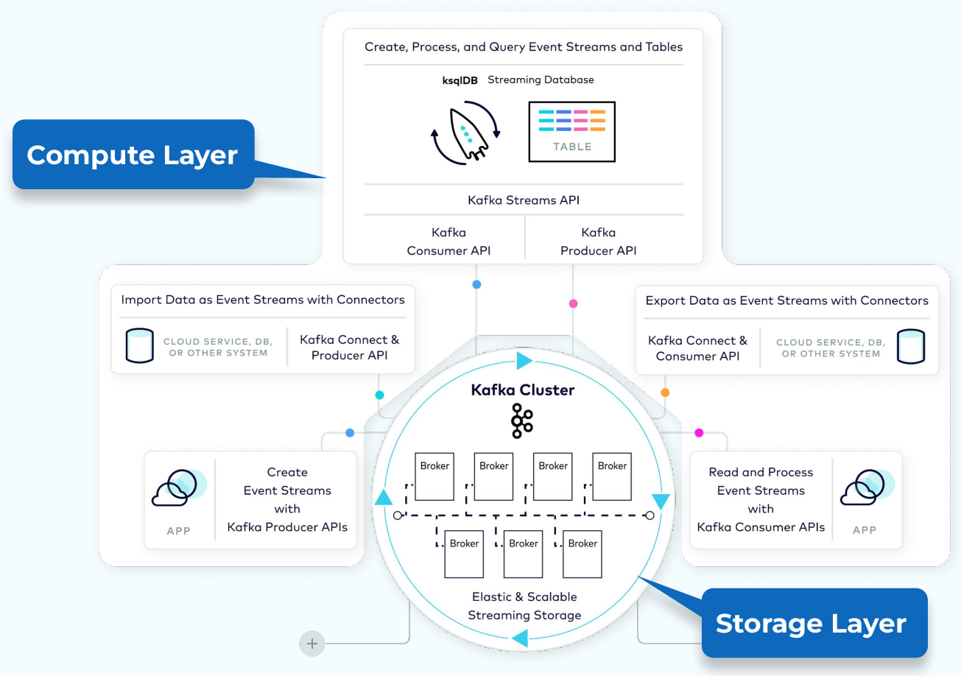

Slide 3
Session Content
Apache Kafka® Brokers: Introduction to the Data Plane

Slide 4
Inside the Apache Kafka Broker

Slide 5
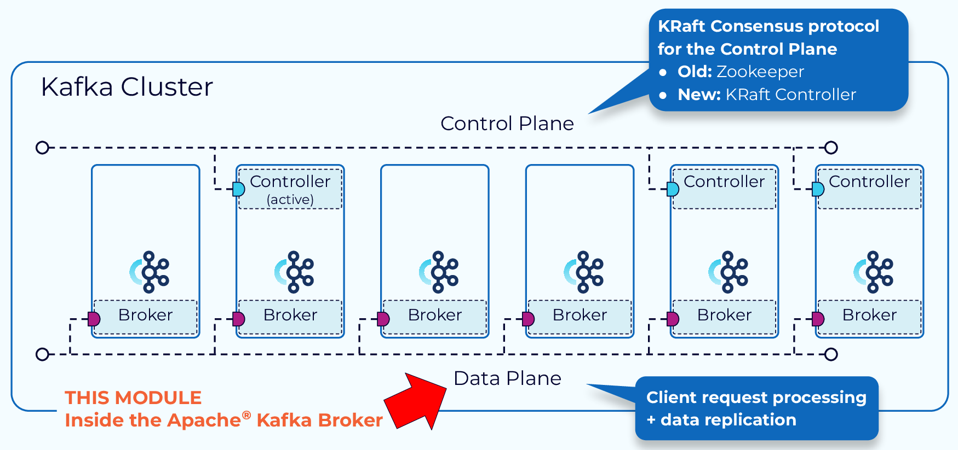
Kafka Manages Data and Metadata Separately

Slide 6
Kafka Manages Data and Metadata Separately
The functions within a Kafka cluster are broken up into a data plane and a control plane.
The control plane handles management of all the metadata in the cluster.
The data plane deals with the actual data that we are writing to and reading from Kafka.
In this module we will focus on how the data plane handles client requests to interact with the data in our Kafka cluster.

Slide 7
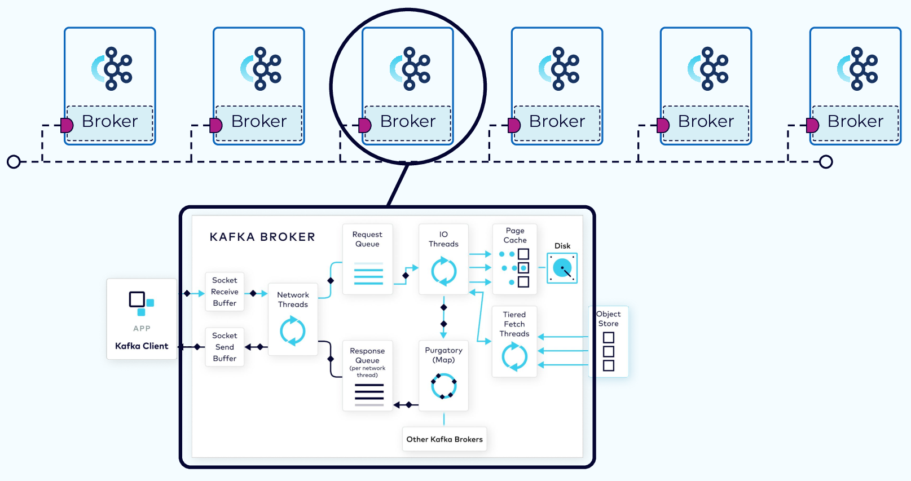
Inside the Apache Kafka Broker

Slide 8
Kafka Request Types
Client requests fall into two categories
produce requests and fetch requests.
A produce request is requesting that a batch of data be written to a specified topic.
A fetch request is requesting data from Kafka topics.
Both types of requests go through many of the same steps.

Slide 9
Produce Request

Slide 10
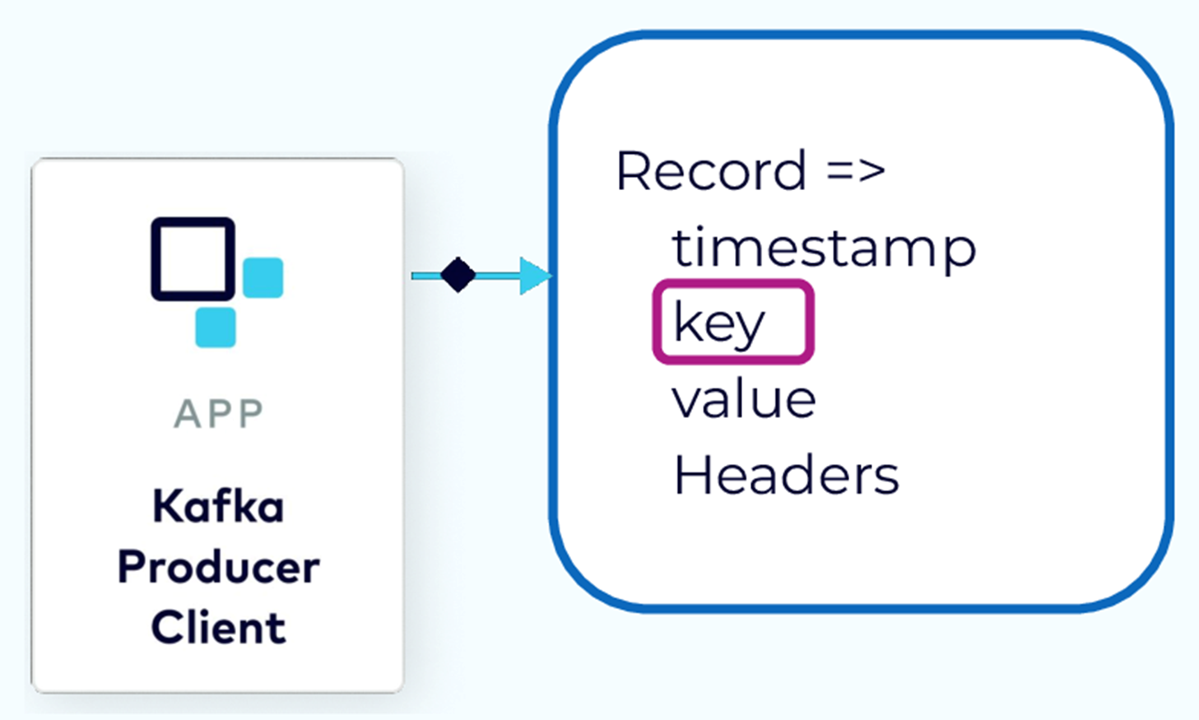
Assign Record to Partition

Slide 11
Assign Record to Partition
When a producer is ready to send an event record, it will use a configurable partitioner to determine the topic partition to assign to the record.
If the record has a key, then the default partitioner will use a hash of the key to determine the correct partition.
After that, any records with the same key will always be assigned to the same partition.
If the record has no key then a partition strategy is used to balance the data in the partitions.

Slide 12
Record Batching

Slide 13
Records Accumulated into Record Batches
Sending records one at a time would be inefficient due to the overhead of repeated network requests.
So, the producer will accumulate the records assigned to a given partition into batches.
Batching also provides for much more effective compression, when compression is used.

Slide 14
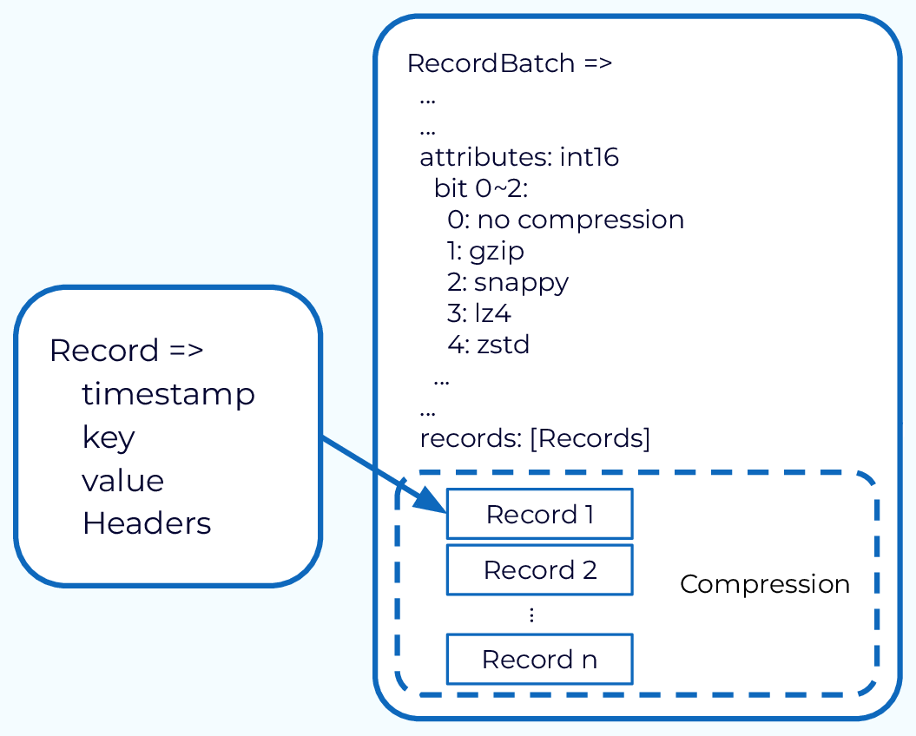
Records Accumulated into Record Batches

Slide 15
Record Batches Drained into Produce Requests
The producer also has control as to when the record batch should be drained and sent to the broker.
This is controlled by two properties. One is by time. The other is by size.
So once enough time or enough data has been accumulated in those record batches, those record batches will be drained, and will form a produce request.
This produce request will then be sent to the broker that is the leader of the included partitions.

Slide 16
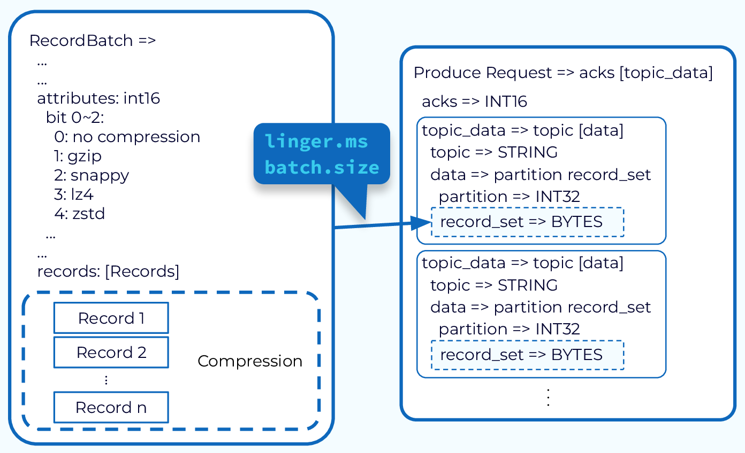
Record Batches Drained into Produce Requests

Slide 17
Network Thread Adds Request to Queue

Slide 18
Network Thread Adds Request to Queue
The request first lands in the broker’s socket receive buffer where it will be picked up by a network thread from the pool.
That network thread will handle that particular client request through the rest of its lifecycle.
The network thread will read the data from the socket buffer, form it into a produce request object, and add it to the request queue.

Slide 19
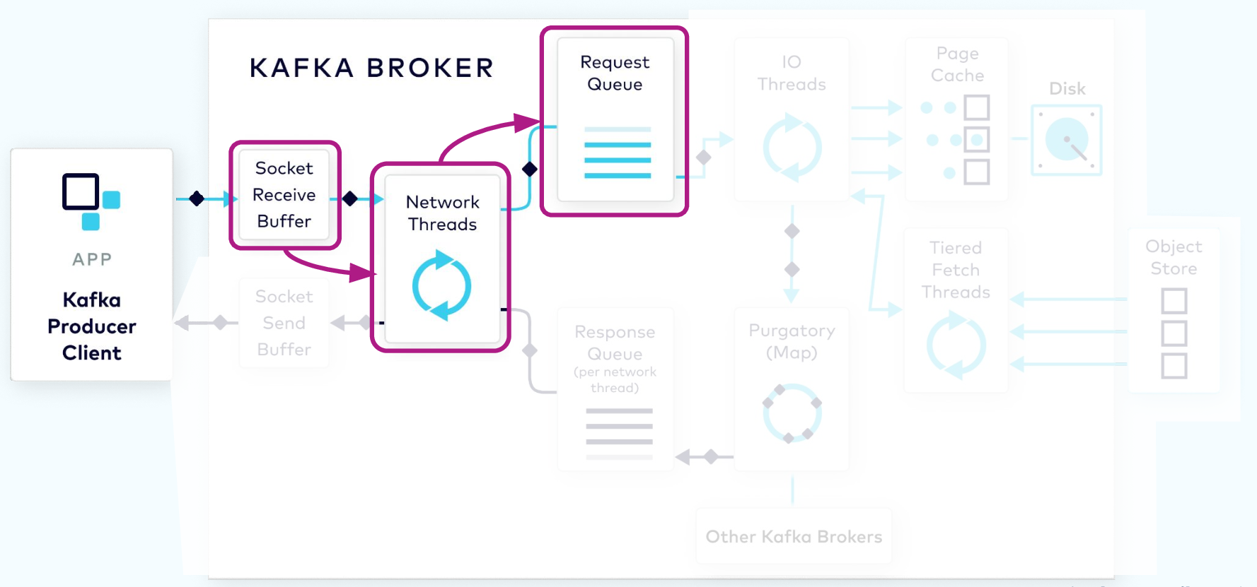

Slide 20
I/O Thread Verifies and Stores the Batch

Slide 21
I/O Thread Verifies and Stores the Batch
Next, a thread from the I/O thread pool will pick up the request from the queue.
The I/O thread will perform some validations, including a CRC check of the data in the request.
It will then append the data to the physical data structure of the partition, which is called a commit log.

Slide 22
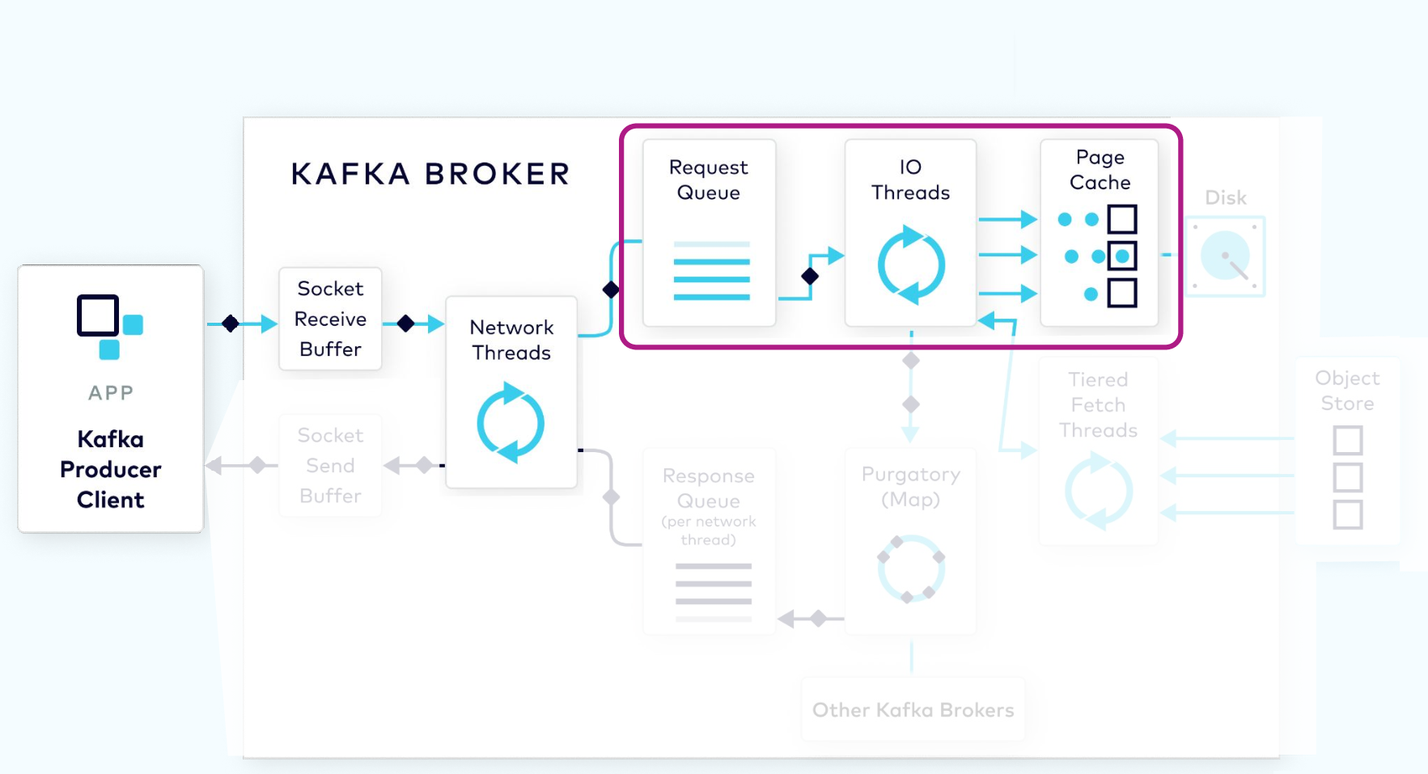
Page cache sometimes also called disk cache, replica of or snapshot of disk content, is kept in main memory

Slide 23
Kafka Physical Storage

Slide 24
Kafka Physical Storage
On disk, the commit log is organized as a collection of segments.
Each segment is made up of several files. One of these, a .log file, contains the event data.
A second, a .index file, contains an index structure, which maps from a record offset to the position of that record in the .log file.

Slide 25
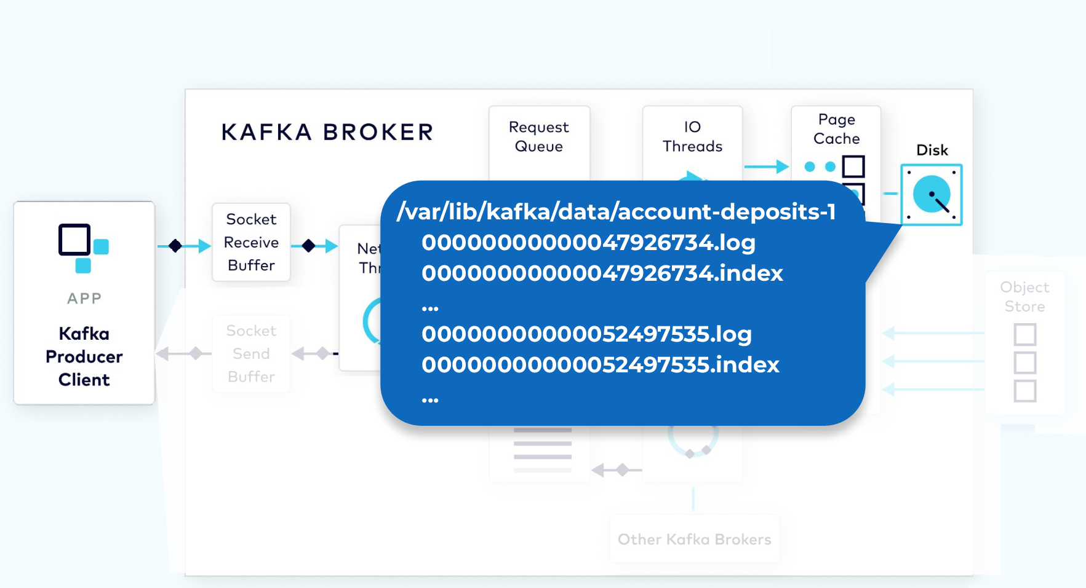

Slide 26
Purgatory Holds Requests Until Replicated

Slide 27
Since the log data is not flushed from the page cache to disk synchronously, Kafka relies on replication to multiple broker nodes, in order to provide durability. By default, the broker will not acknowledge the produce request until it has been replicated to other brokers.
To avoid tying up the I/O threads while waiting for the replication step to complete, the request object will be stored in a map-like data structure called purgatory (it’s where things go to wait).
Once the request has been fully replicated, the broker will take the request object out of purgatory, generate a response object, and place it on the response queue.

Slide 28
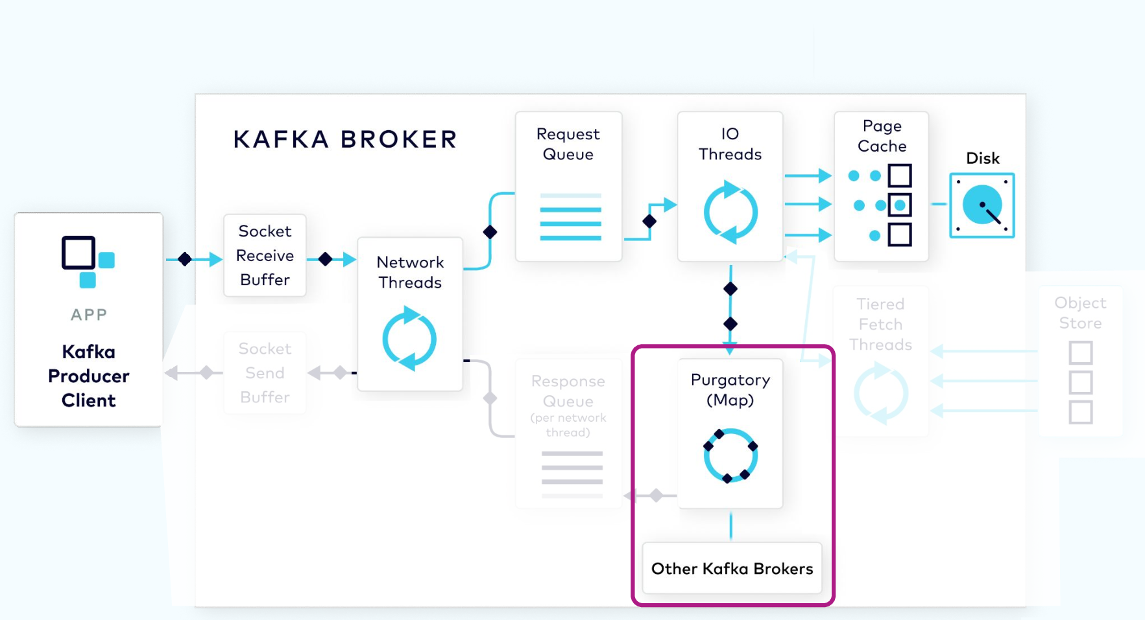

Slide 29
Response Added to Socket

Slide 30
Response Added to Socket
From the response queue, the network thread will pick up the generated response, and send its data to the socket send buffer.
The network thread also enforces ordering of requests from an individual client by waiting for all of the bytes for a response from that client to be sent before taking another object from the response queue.

Slide 31
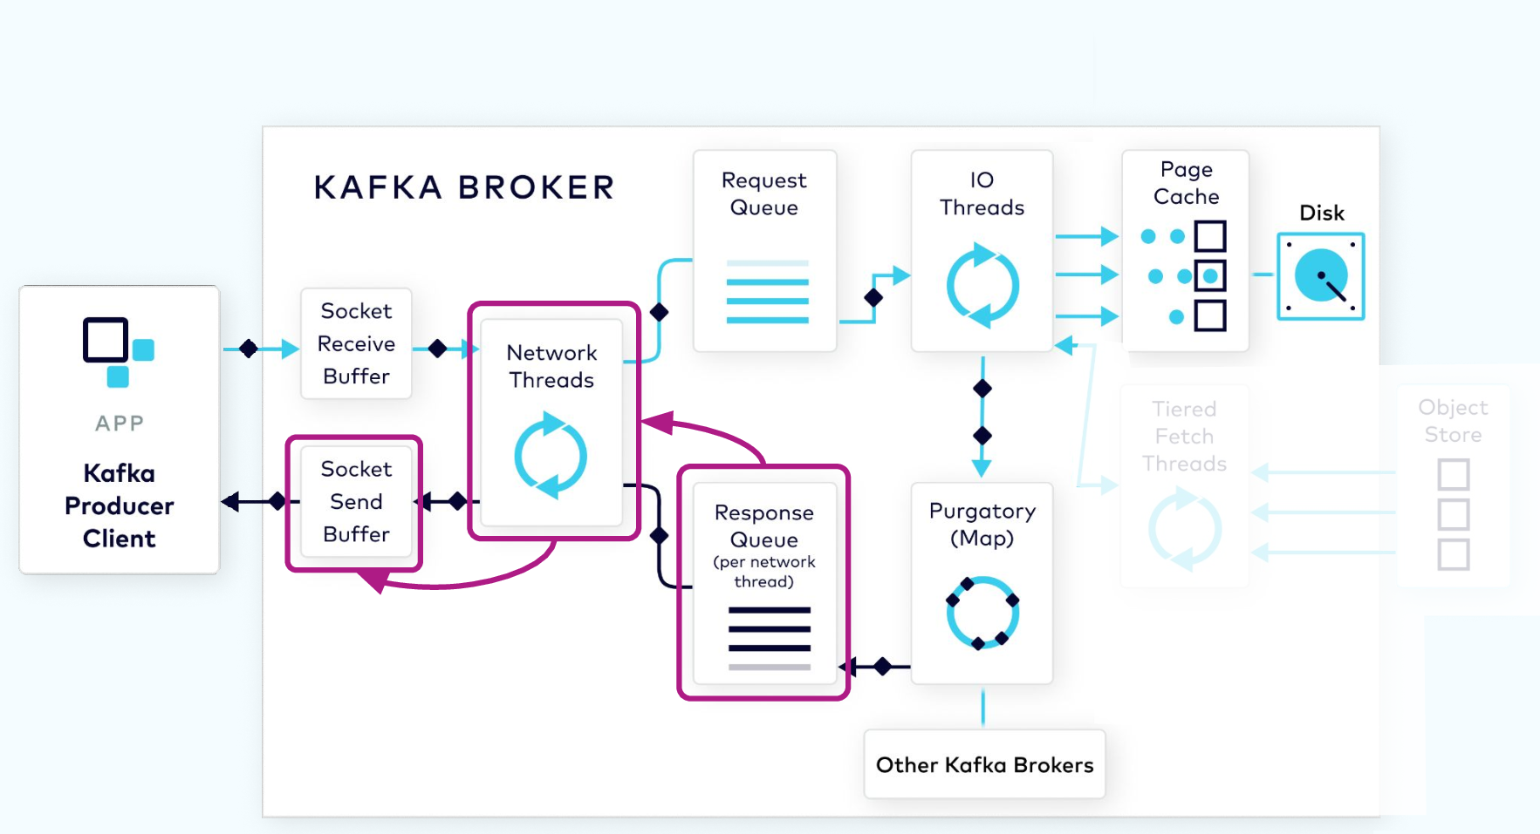

Slide 32
The Fetch Request Consumer Side

Slide 33
Fetch Request Work Flow
In order to consume records, a consumer client sends a fetch request to the broker, specifying the topic, partition, and offset it wants to consume.
The fetch request goes to the broker’s socket receive buffer where it is picked up by a network thread.
The network thread puts the request in the request queue, as was done with the produce request.
The I/O thread will take the offset that is included in the fetch request and compare it with the .index file that is part of the partition segment.

Slide 34
Fetch Request Work Flow
That will tell it exactly the range of bytes that need to be read from the corresponding .log file to add to the response object.
However, it would be inefficient to send a response with every record fetched, or even worse, when there are no records available.
To be more efficient, consumers can be configured to wait for a minimum number of bytes of data, or to wait for a maximum amount of time before returning a response to a fetch request.
While waiting for these criteria to be met, the fetch request is sent to purgatory
Once the size or time requirements have been met, the broker will take the fetch request out of purgatory and generate a response to be sent back to the client. The rest of the process is the same as the produce request.

Slide 35
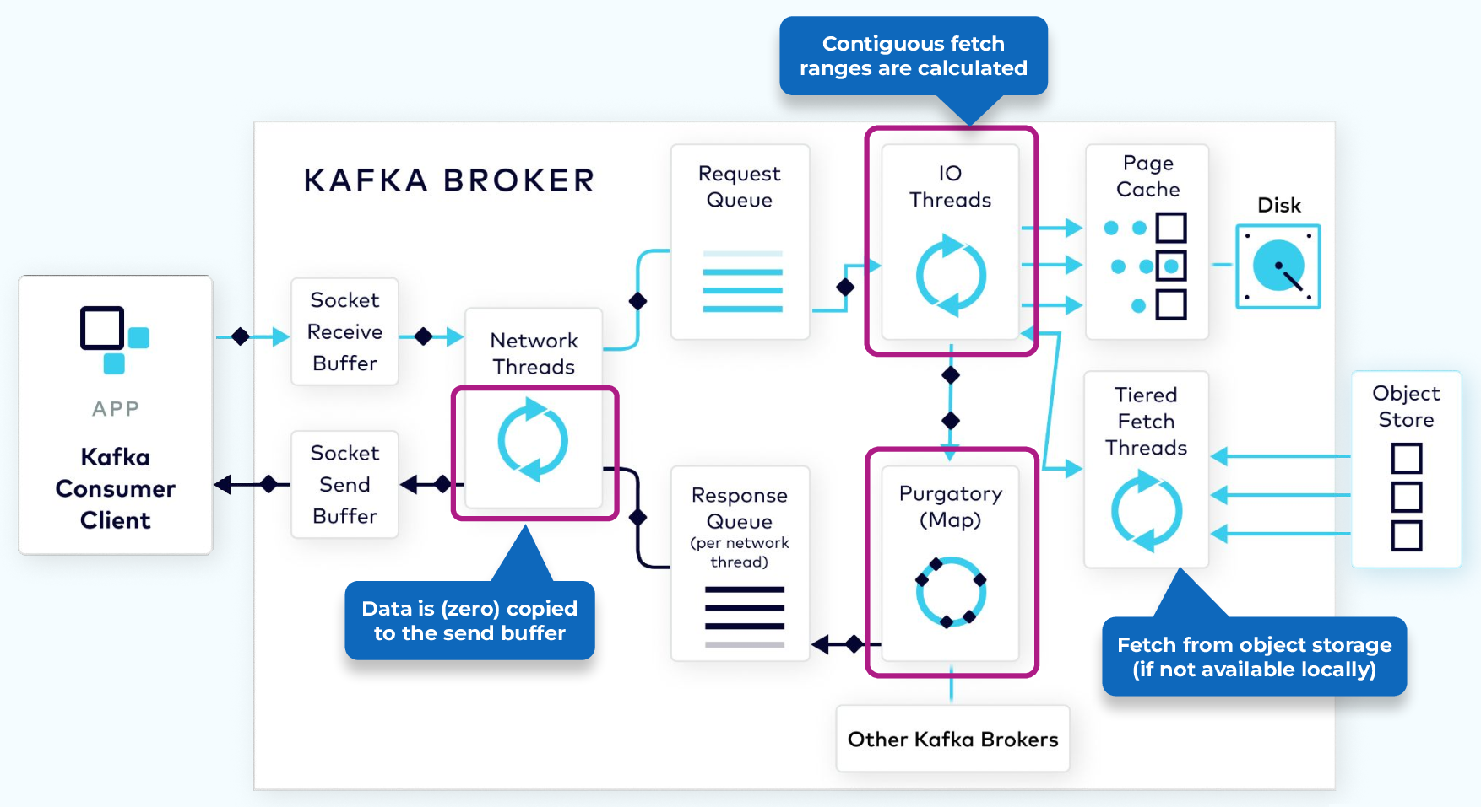

Slide 36
Data Plane: Replication Protocol

Slide 37
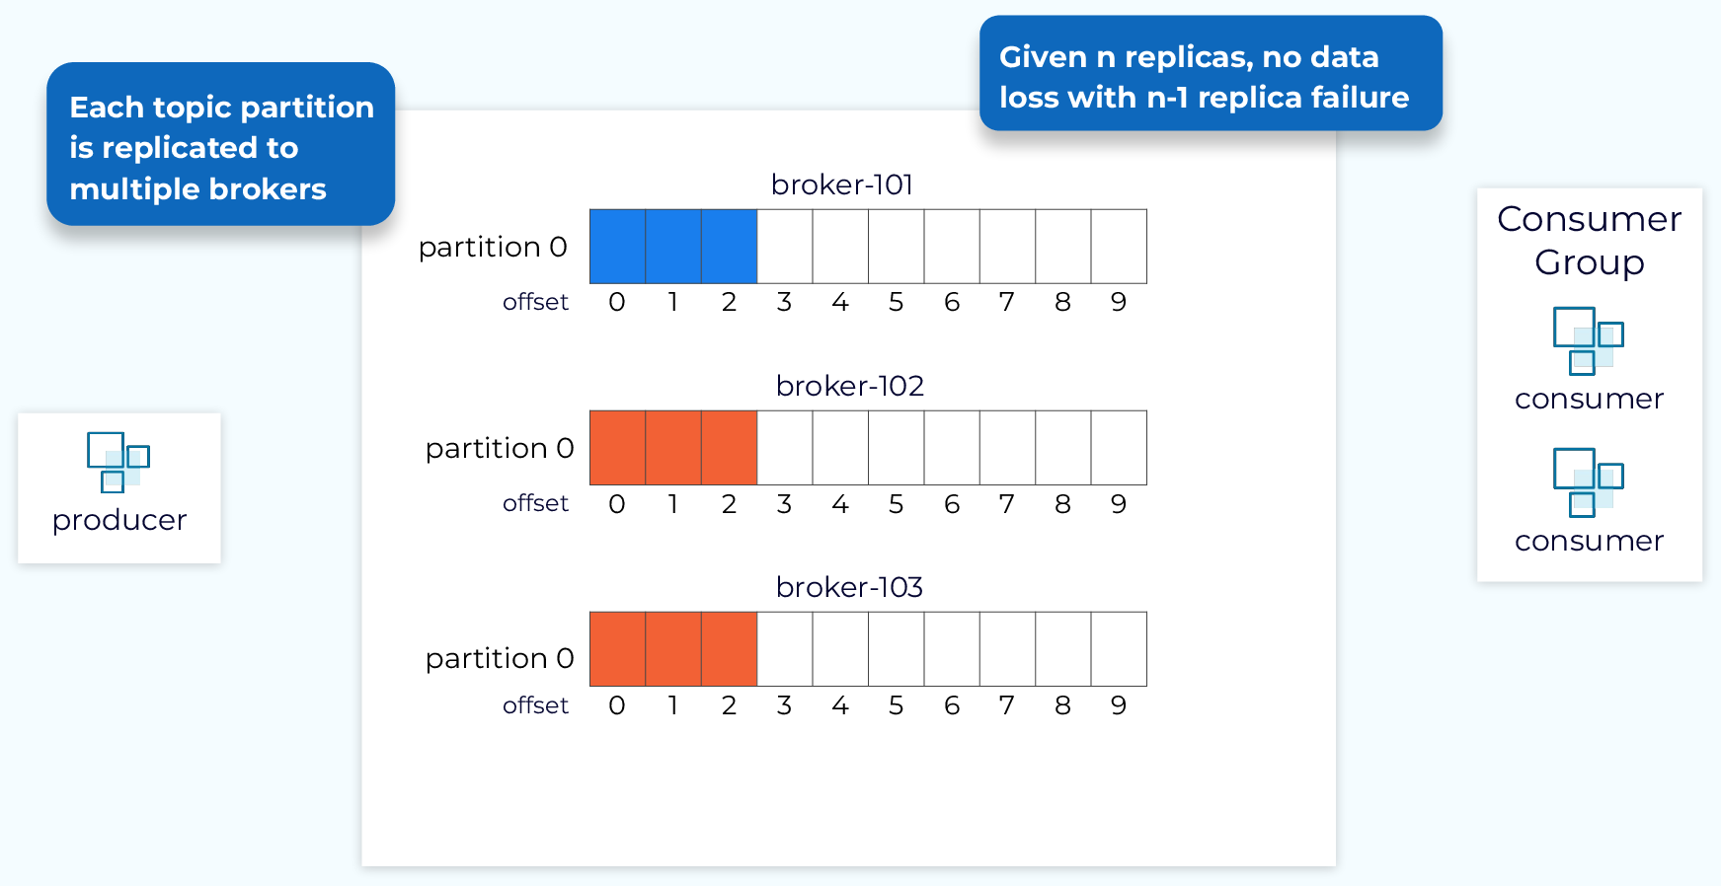
Data Plane: Replication Protocol

Slide 38
Data Replication
Data replication is a critical feature of Kafka that allows it to provide high durability and availability.
We enable replication at the topic level. When a new topic is created we can specify, explicitly or through defaults, how many replicas we want.
Then each partition of that topic will be replicated that many times. This number is referred to as the replication factor. With a replication factor of N, in general, we can tolerate N-1 failures, without data loss, and while maintaining availability.

Slide 39
Leader, Follower, and In-Sync Replica (ISR) List
Once the replicas for all the partitions in a topic are created, one replica of each partition will be designated as the leader replica and the broker that holds that replica will be the leader for that partition.
The remaining replicas will be followers. Producers will write to the leader replica and the followers will fetch the data in order to keep in sync with the leader.
Consumers also, generally, fetch from the leader replica, but they can be configured to fetch from followers.
The partition leader, along with all of the followers that have caught up with the leader, will be part of the in-sync replica set (ISR). In the ideal situation, all of the replicas will be part of the ISR.

Slide 40
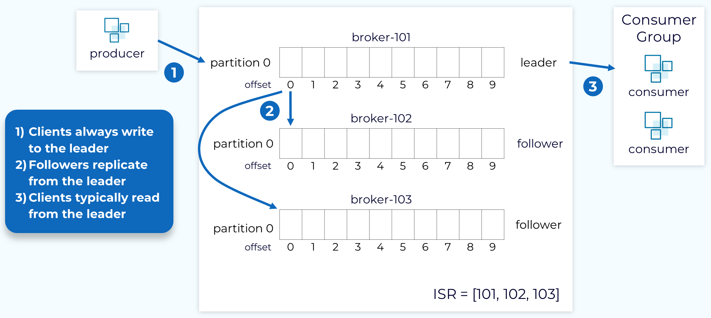
Leader, Follower, and In-Sync Replica (ISR) List

Slide 41
Leader Epoch

Slide 42
Leader Epoch
Each leader is associated with a unique, monotonically increasing number called the leader epoch.
The epoch is used to keep track of what work was done while this replica was the leader and it will be increased whenever a new leader is elected. The leader epoch is very important for things like log reconciliation, which we’ll discuss shortly.

Slide 43
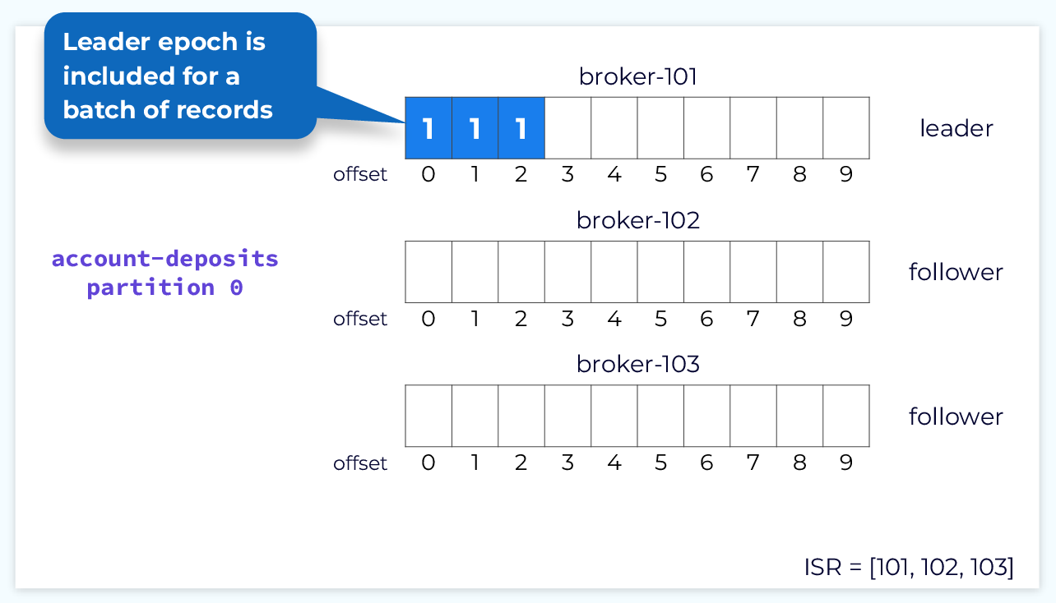

Slide 44
Follower Fetch Request

Slide 45
Follower Request
Whenever the leader appends new data into its local log, the followers will issue a fetch request to the leader, passing in the offset at which they need to begin fetching.

Slide 46
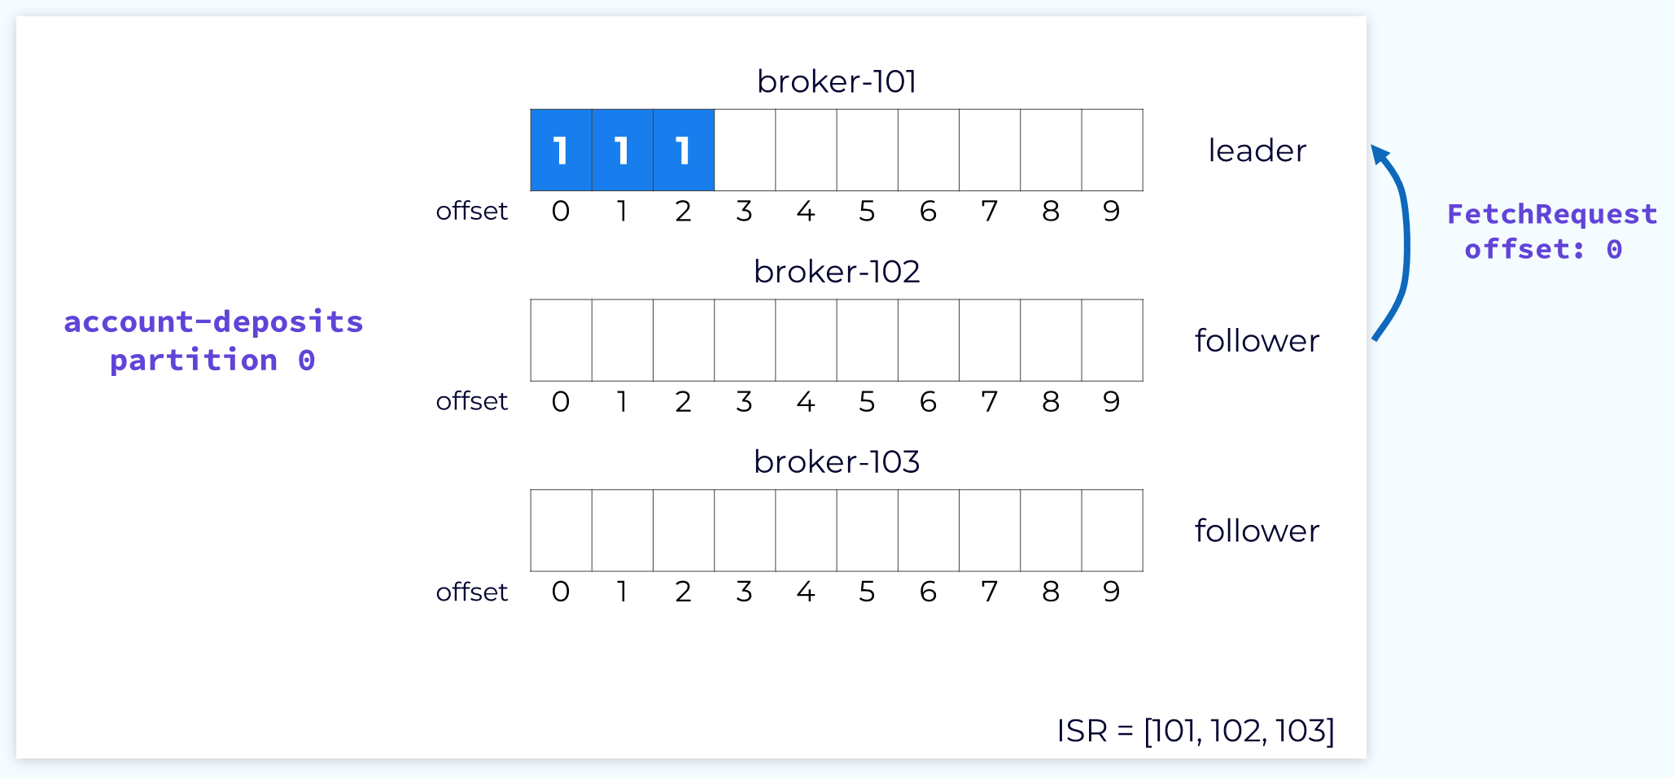

Slide 47
Follower Fetch Response

Slide 48
Follower Response
The leader will respond to the fetch request with the records starting at the specified offset.
The fetch response will also include the offset for each record and the current leader epoch.
The followers will then append those records to their own local logs.

Slide 49
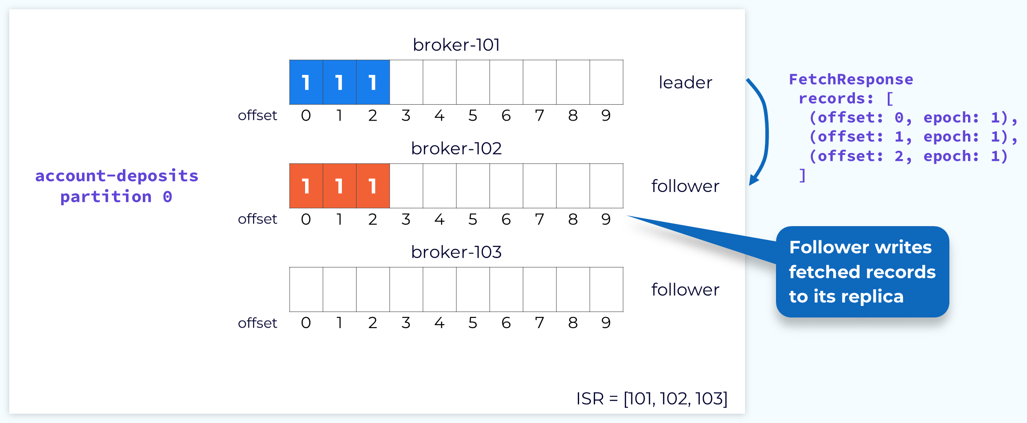

Slide 50
Committing Partition offsets
Once all of the followers in the ISR have fetched up to a particular offset, the records up to that offset are considered committed and are available for consumers. This is designated by the high watermark.
The leader is made aware of the highest offset fetched by the followers through the offset value sent in the fetch requests. For example, if a follower sends a fetch request to the leader that specifies offset 3, the leader knows that this follower has committed all records up to offset 3. Once all of the followers have reached offset 3, the leader will advance the high watermark accordingly.

Slide 51
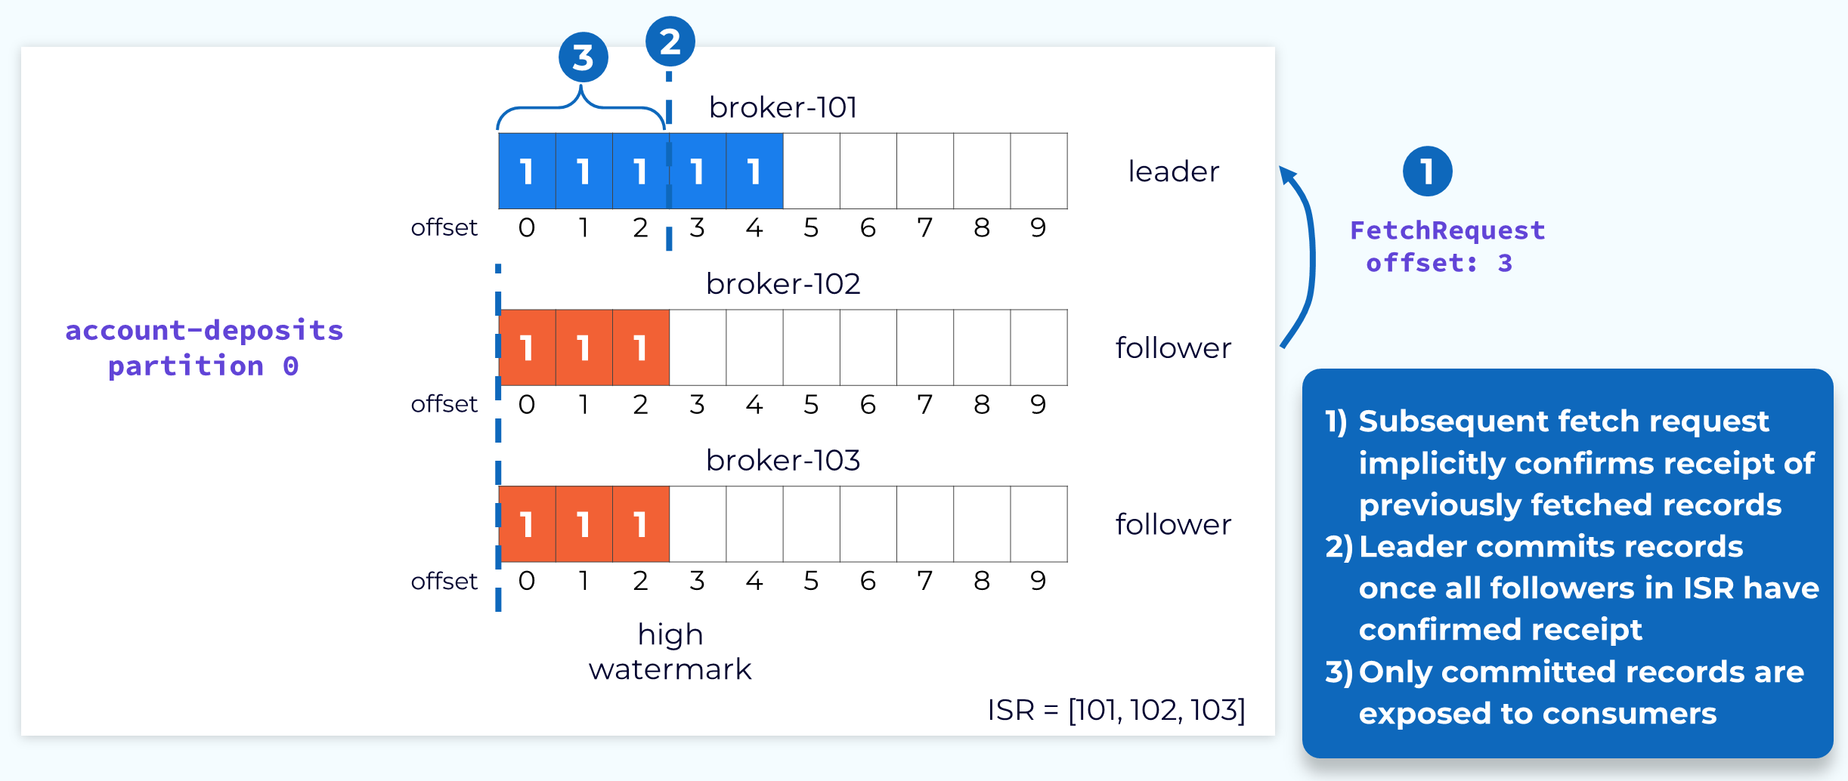
Committing Partition Offsets

Slide 52
Advancing the Follower watermark
The leader, in turn, uses the fetch response to inform followers of the current high watermark.
Because this process is asynchronous, the followers’ high watermark will typically lag behind the actual high watermark held by the leader.

Slide 53
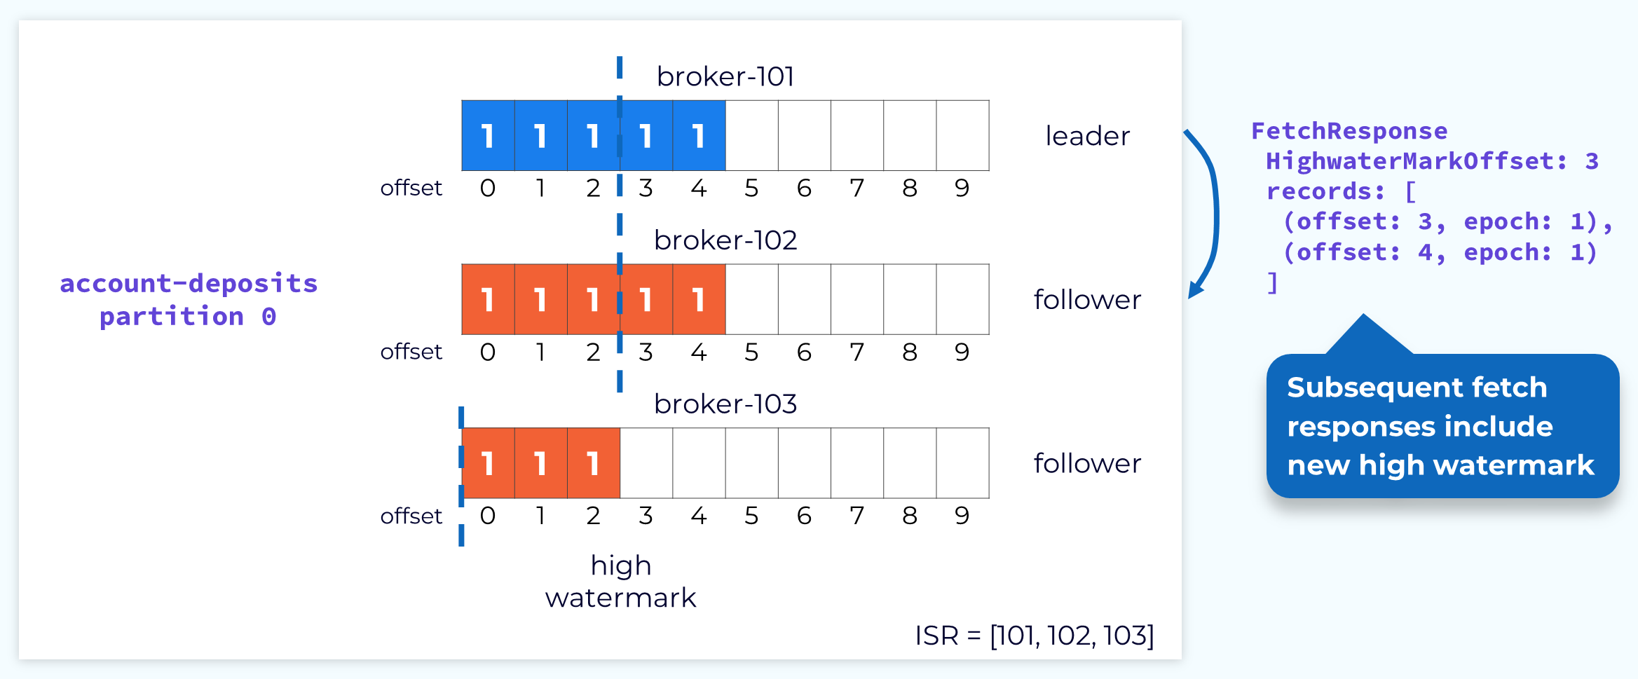
Advancing the Follower High Watermark

Slide 54
Handling Leader failure
If a leader fails, or if for some other reason we need to choose a new leader, one of the brokers in the ISR will be chosen as the new leader. The process of leader election and notification of affected followers is handled by the control plane. The important thing for the data plane is that no data is lost in the process. That is why a new leader can only be selected from the ISR, unless the topic has been specifically configured to allow replicas that are not in sync to be selected. We know that all of the replicas in the ISR are up to date with the latest committed offset.
Once a new leader is elected, the leader epoch will be incremented and the new leader will begin accepting produce requests.

Slide 55
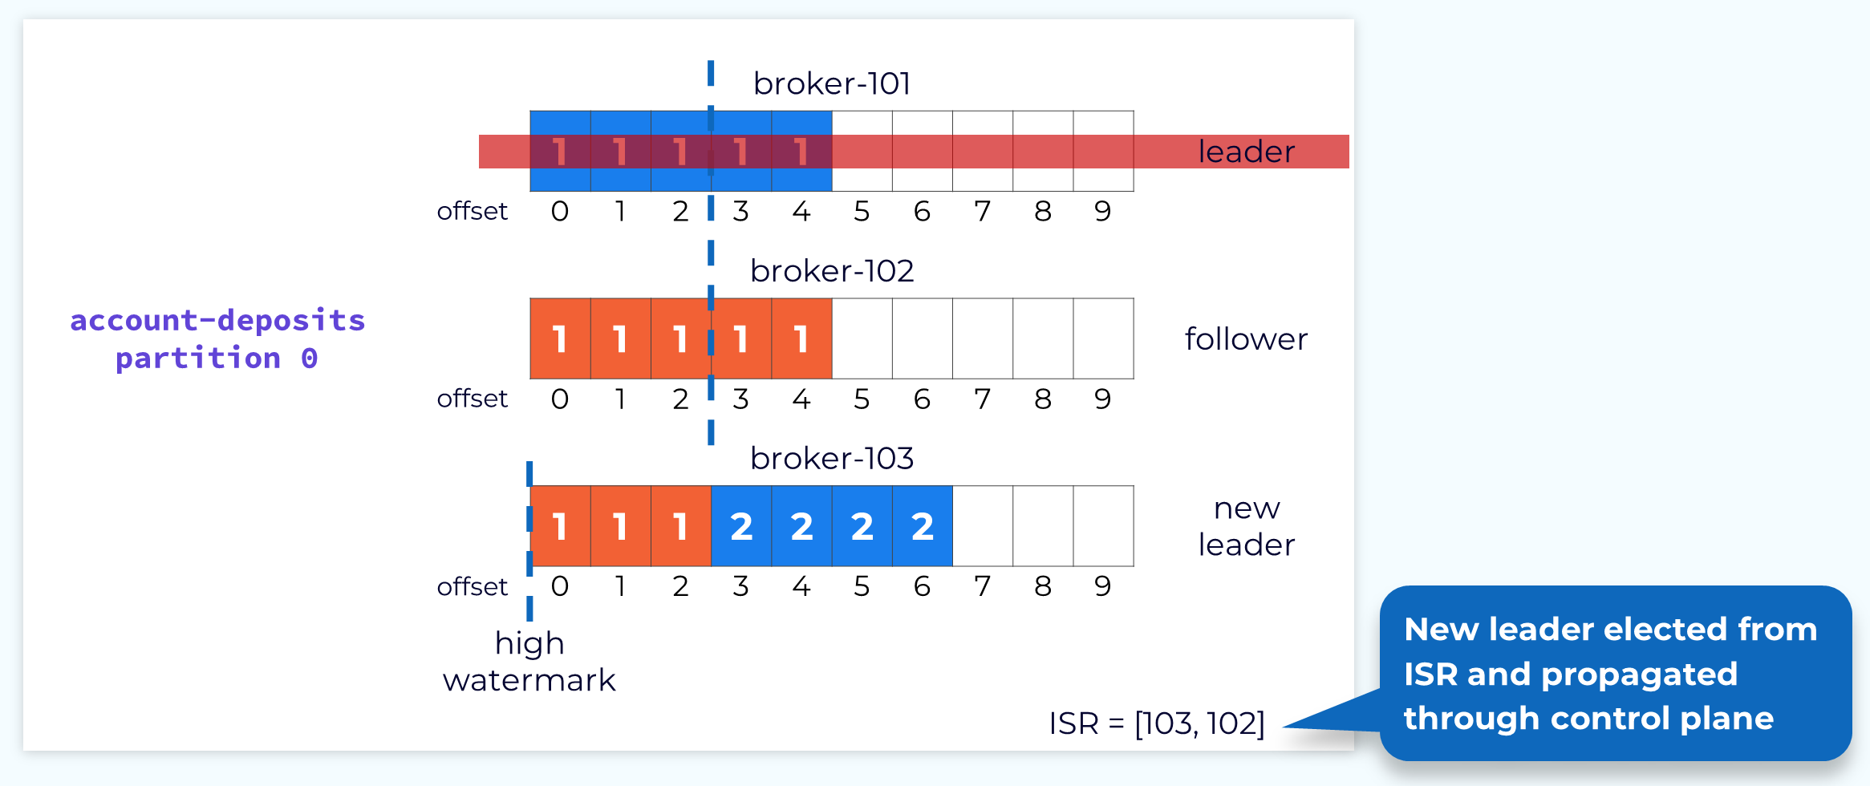
Handling Leader Failure

Slide 56
Temporary Decreased High Watermark
When a new leader is elected, its high watermark could be less than the actual high watermark. If this happens, any fetch requests for an offset that is between the current leader’s high watermark and the actual will trigger a retriable OFFSET_NOT_AVAILABLE error. The consumer will continue trying to fetch until the high watermark is updated, at which point processing will continue as normal

Slide 57
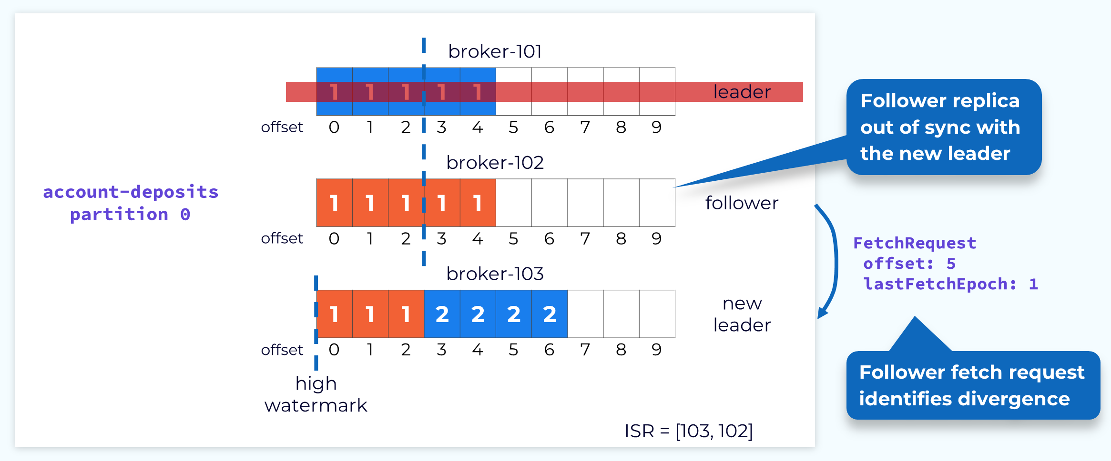
Temporary Decreased High Watermark

Slide 58
Partition Replica Reconciliation
Immediately after a new leader election, it is possible that some replicas may have uncommitted records that are out of sync with the new leader.
This is why the leader's high watermark is not current yet. It can’t be until it knows the offset that each follower has caught up to.
We can’t move forward until this is resolved. This is done through a process called replica reconciliation.
The first step in reconciliation begins when the out-of-sync follower sends a fetch request. In our example, the request shows that the follower is fetching an offset that is higher than the high watermark for its current epoch.

Slide 60
Fetch Response Informs Follower of Divergence
When the leader receives the fetch request it will check it against its own log and determine that the offset being requested is not valid for that epoch.
It will then send a response to the follower telling it what offset that epoch should end at. The leader leaves it to the follower to perform the cleanup.

Slide 61
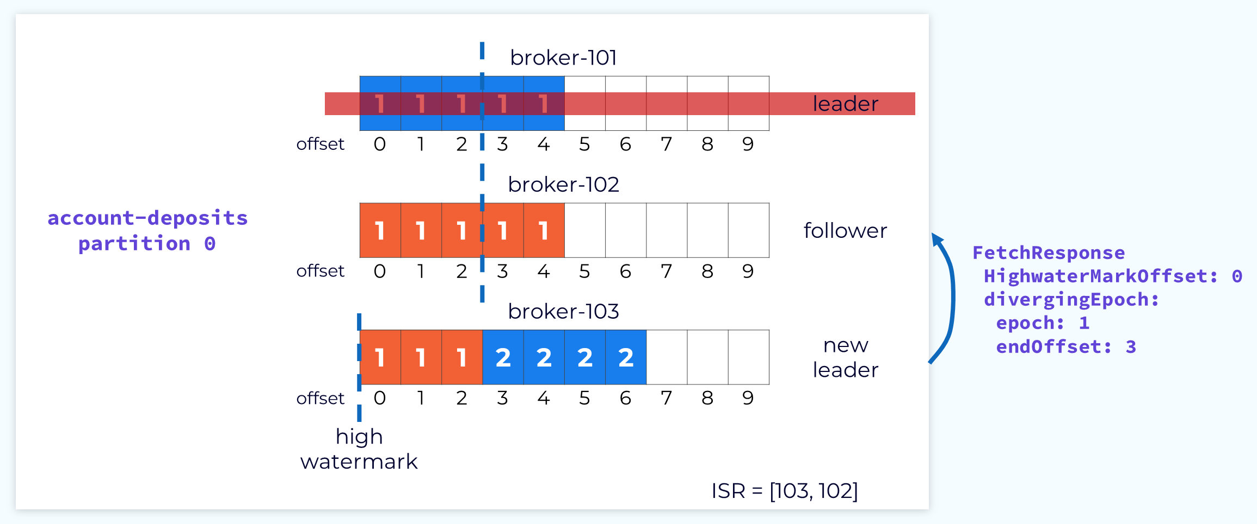
Fetch Response Informs Follower of Divergence

Slide 62
Follower Truncates Log to Match Leader Log
The follower will use the information in the fetch response to truncate the extraneous data so that it will be in sync with the leader.

Slide 63
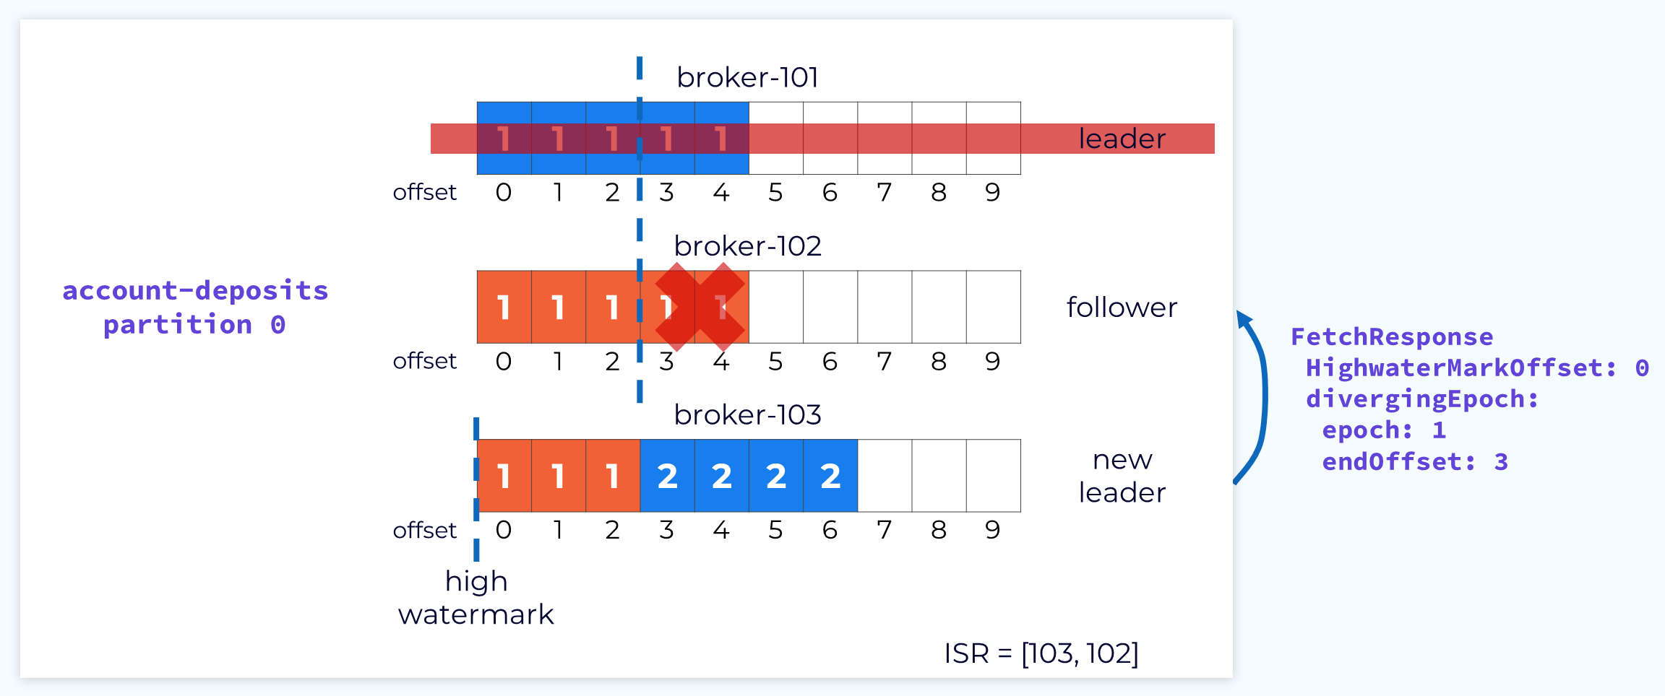
Follower Truncates Log to Match Leader Log

Slide 64
Subsequent Fetch with Updated Offset and Epoch
Now the follower can send that fetch request again, but this time with the correct offset.

Slide 65
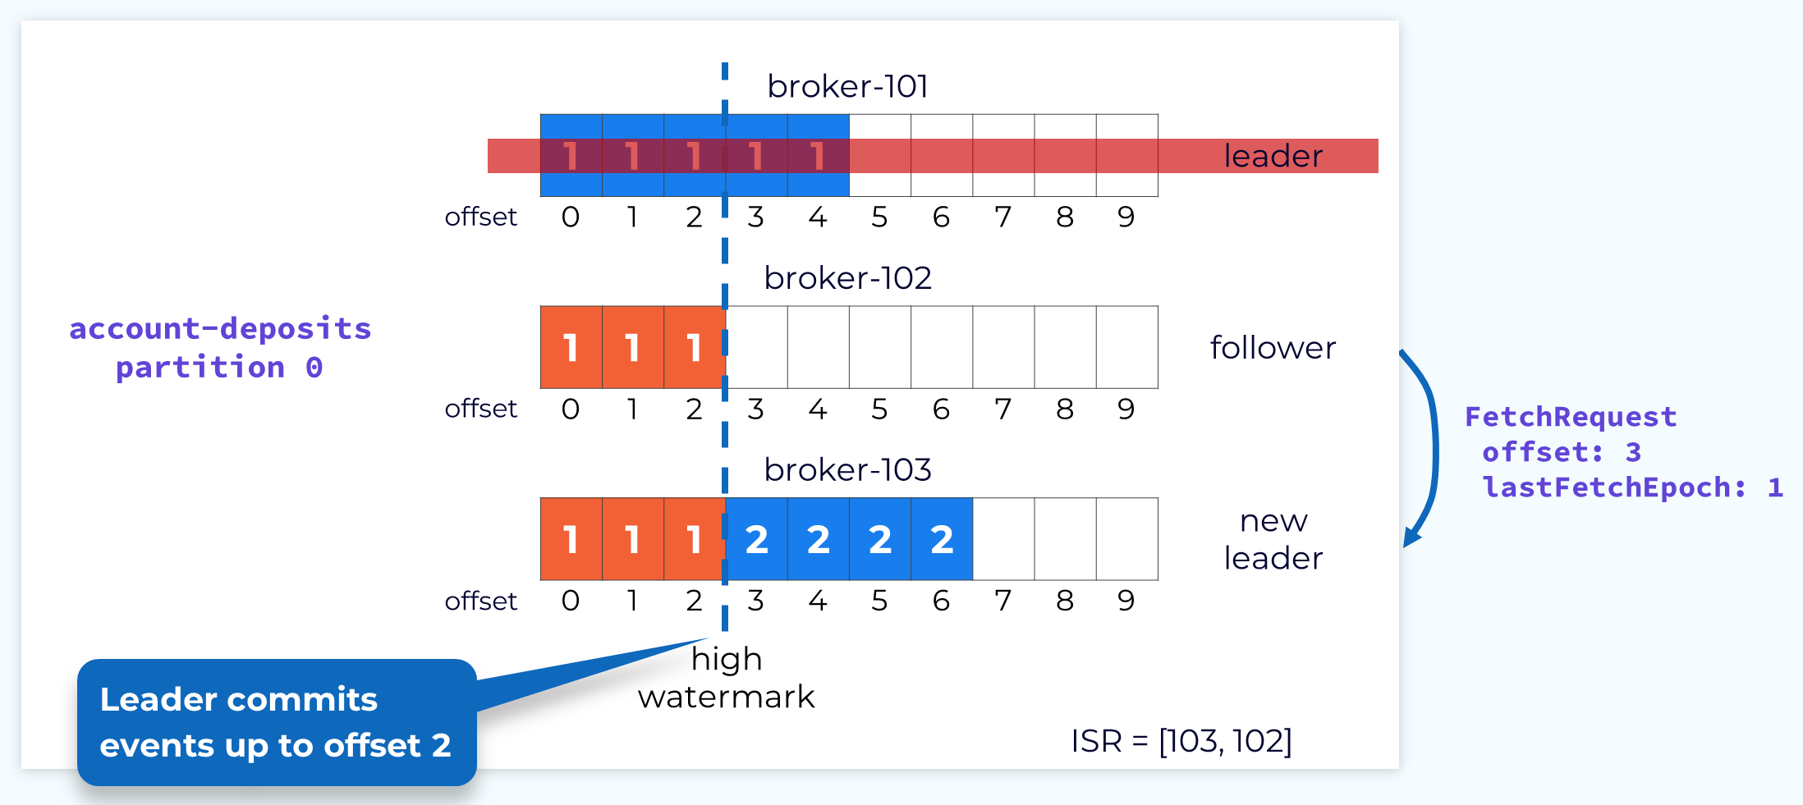
Subsequent Fetch with Updated Offset and Epoch

Slide 66
Follower 102 Reconciled
The leader will then respond with the new records since that offset includes the new leader epoch.

Slide 67
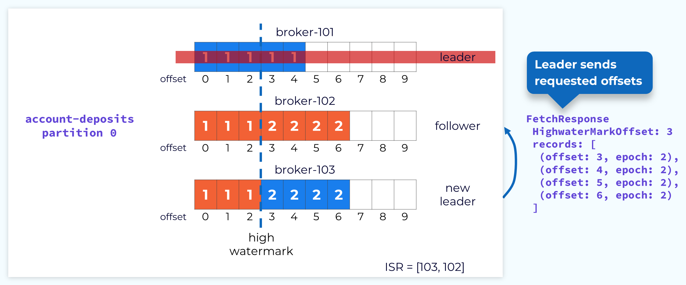
Follower 102 Reconciled
The leader will then respond with the new records since that offset includes the new leader epoch.

Slide 68
Follower 102 Acknowledges New Records
When the follower fetches again, the offset that it passes will inform the leader that it has caught up and the leader will be able to increase the high watermark. At this point the leader and follower are fully reconciled, but we are still in an under replicated state because not all of the replicas are in the ISR. Depending on configuration, we can operate in this state, but it’s certainly not ideal.

Slide 69
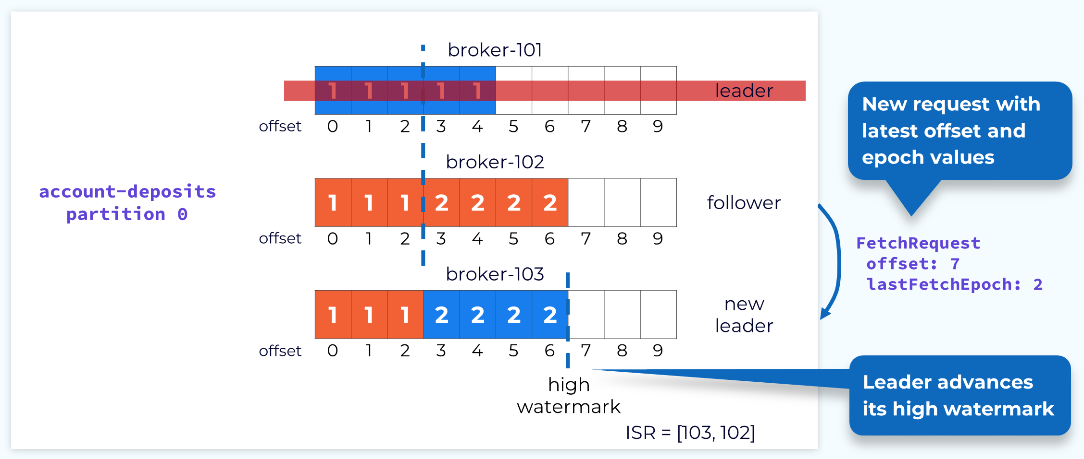
Follower 102 Acknowledges New Records

Slide 70
Follower 101 Rejoins the Cluster
At some point, hopefully soon, the failed replica broker will come back online. It will then go through the same reconciliation process that we just described. Once it is done reconciling and is caught up with the new leader, it will be added back to the ISR and we will be back in our happy place.

Slide 71
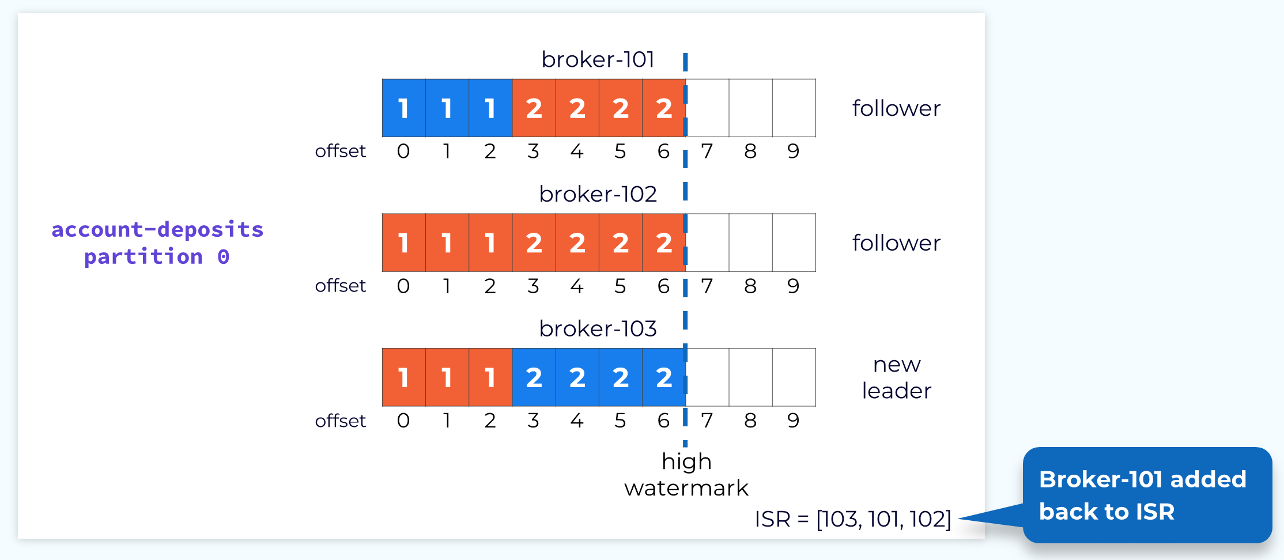
Follower 101 Rejoins the Cluster

Slide 72
Handling Failed or Slow Followers
Obviously when a leader fails, it’s a bigger deal, but we also need to handle follower failures as well as followers that are running slow. The leader monitors the progress of its followers. If a configurable amount of time elapses since a follower was last fully caught up, the leader will remove that follower from the in-sync replica set. This allows the leader to advance the high watermark so that consumers can continue consuming current data. If the follower comes back online or otherwise gets its act together and catches up to the leader, then it will be added back to the ISR.

Slide 73
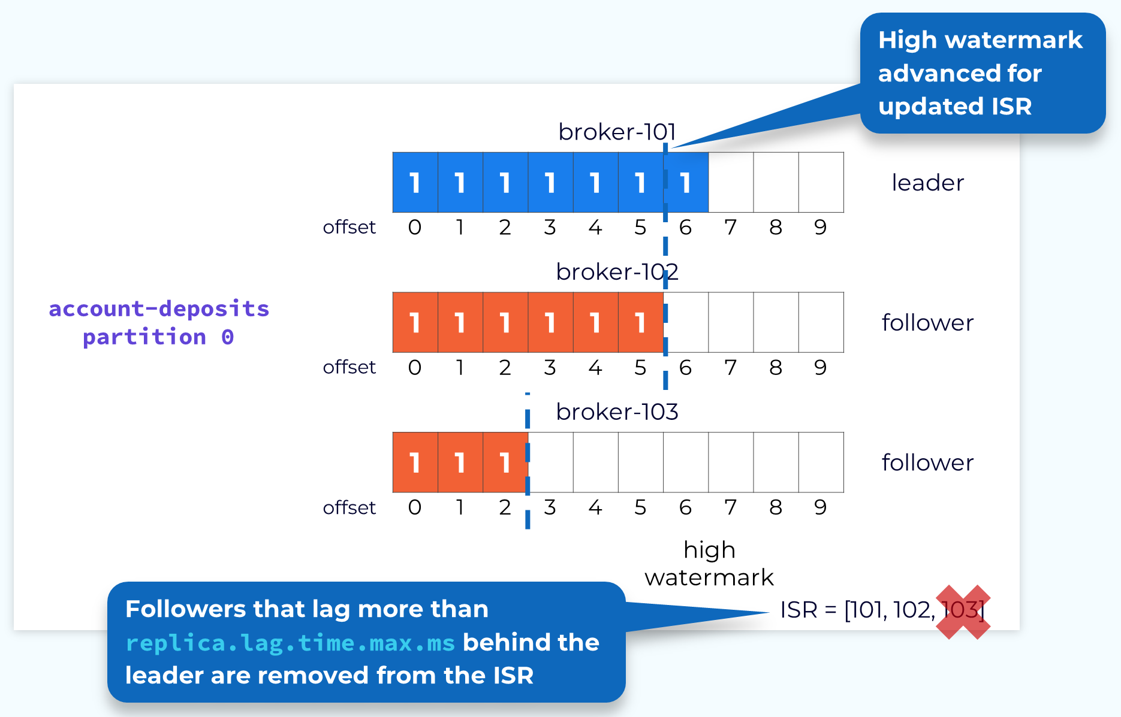
Handling Failed or Slow Followers

Slide 74
Partition Leader Balancing
As we’ve seen, the broker containing the leader replica does a bit more work than the follower replicas. Because of this it’s best not to have a disproportionate number of leader replicas on a single broker. To prevent this Kafka has the concept of a preferred replica. When a topic is created, the first replica for each partition is designated as the preferred replica. Since Kafka is already making an effort to evenly distribute partitions across the available brokers, this will usually result in a good balance of leaders.
As leader elections occur for various reasons, the leaders might end up on non-preferred replicas and this could lead to an imbalance. So, Kafka will periodically check to see if there is an imbalance in leader replicas. It uses a configurable threshold to make this determination. If it does find an imbalance it will perform a leader rebalance to get the leaders back on their preferred replicas

Slide 75
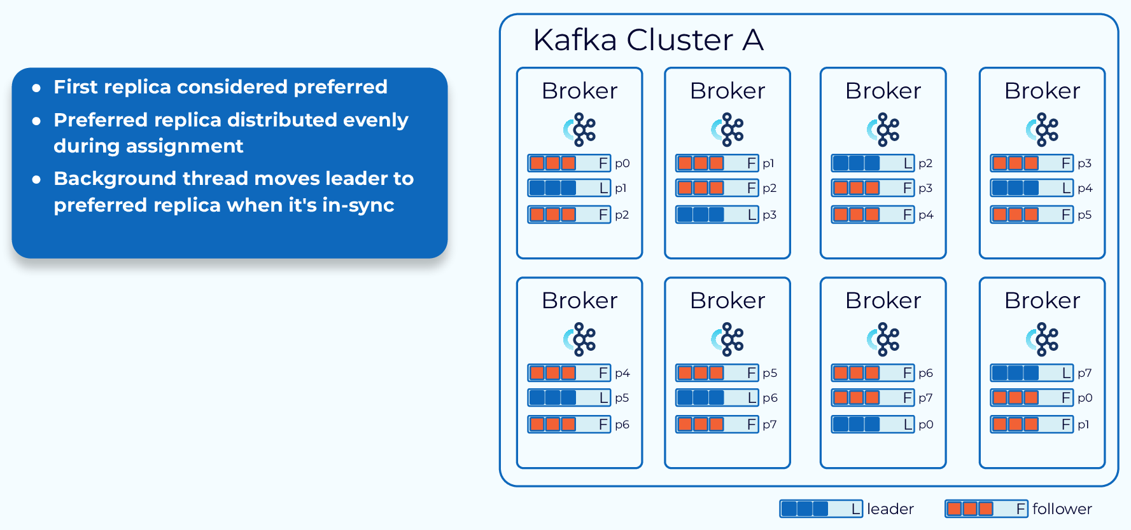
Partition Leader Balancing

Slide 76
Control Plane

Slide 77
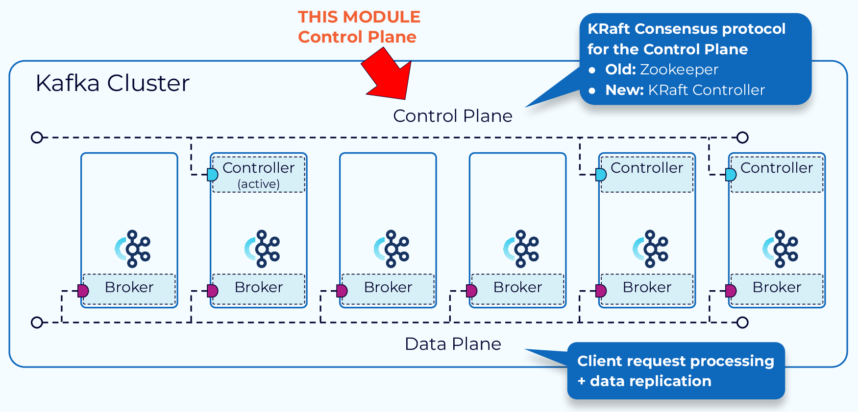

Slide 78
Zoo Keeper Mode

Slide 79
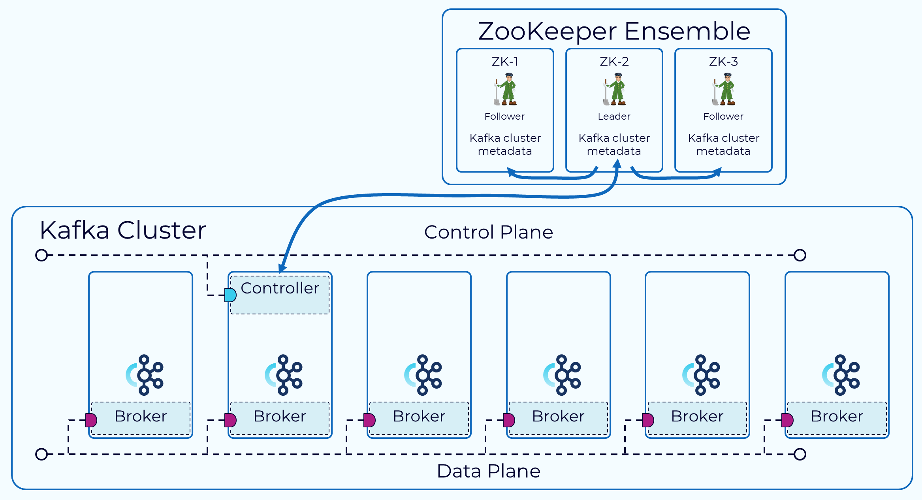

Slide 80
Historically, the Kafka control plane was managed through an external consensus service called ZooKeeper.
One broker is designated as the controller.
The controller is responsible for communicating with ZooKeeper and the other brokers in the cluster.
The metadata for the cluster is persisted in ZooKeeper.

Slide 81
KRaft Mode

Slide 82
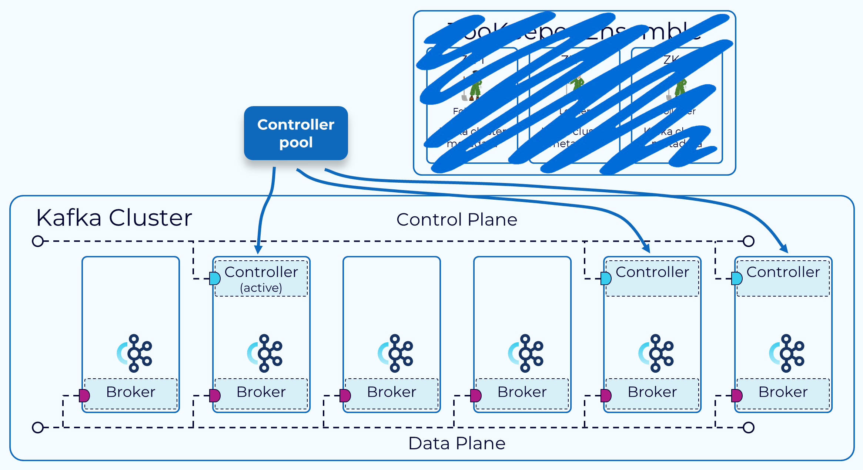

Slide 83
Going forward, the Kafka control plane will be based on a new internal feature called KRaft.
The dependency on ZooKeeper will be eliminated. In KRaft, a subset of brokers are designated as controllers, and these controllers provide the consensus services that used to be provided by ZooKeeper.
All cluster metadata will be stored in Kafka topics and managed internally.

Slide 84
Advantages
Simpler deployment and administration – By having only a single application to install and manage, Kafka now has a much smaller operational footprint. This also makes it easier to take advantage of Kafka in smaller devices at the edge.
Improved scalability – As shown in the diagram, recovery time is an order of magnitude faster with KRaft than with ZooKeeper. This allows us to efficiently scale to millions of partitions in a single cluster. With ZooKeeper the effective limit was in the tens of thousands.
More efficient metadata propagation – Log-based, event-driven metadata propagation results in improved performance for many of Kafka’s core functions

Slide 85
Kraft Cluster Nodes Roles

Slide 86
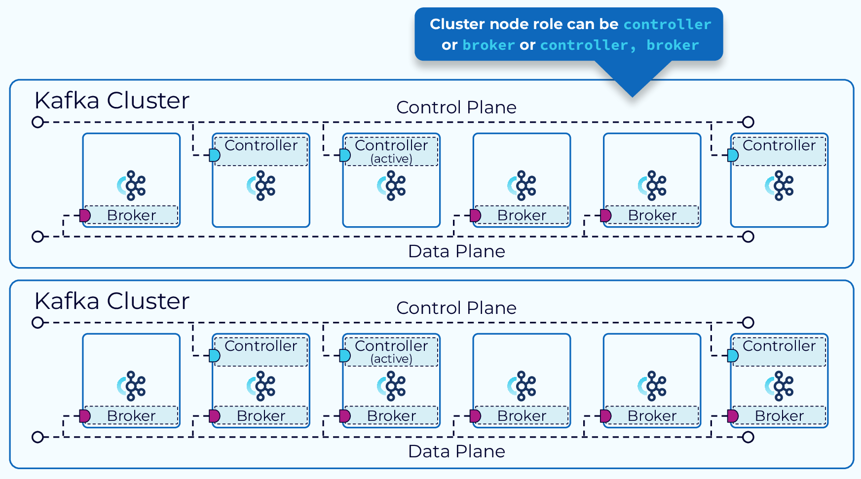

Slide 87
Kraft Mode
In KRaft mode, a Kafka cluster can run in dedicated or shared mode.
In dedicated mode, some nodes will have their process.roles configuration set to controller, and the rest of the nodes will have it set to broker.
For shared mode, some nodes will have process.roles set to controller, broker and those nodes will do double duty. Which way to go will depend on the size of your cluster.

Slide 88
KRaft Mode Controller

Slide 89
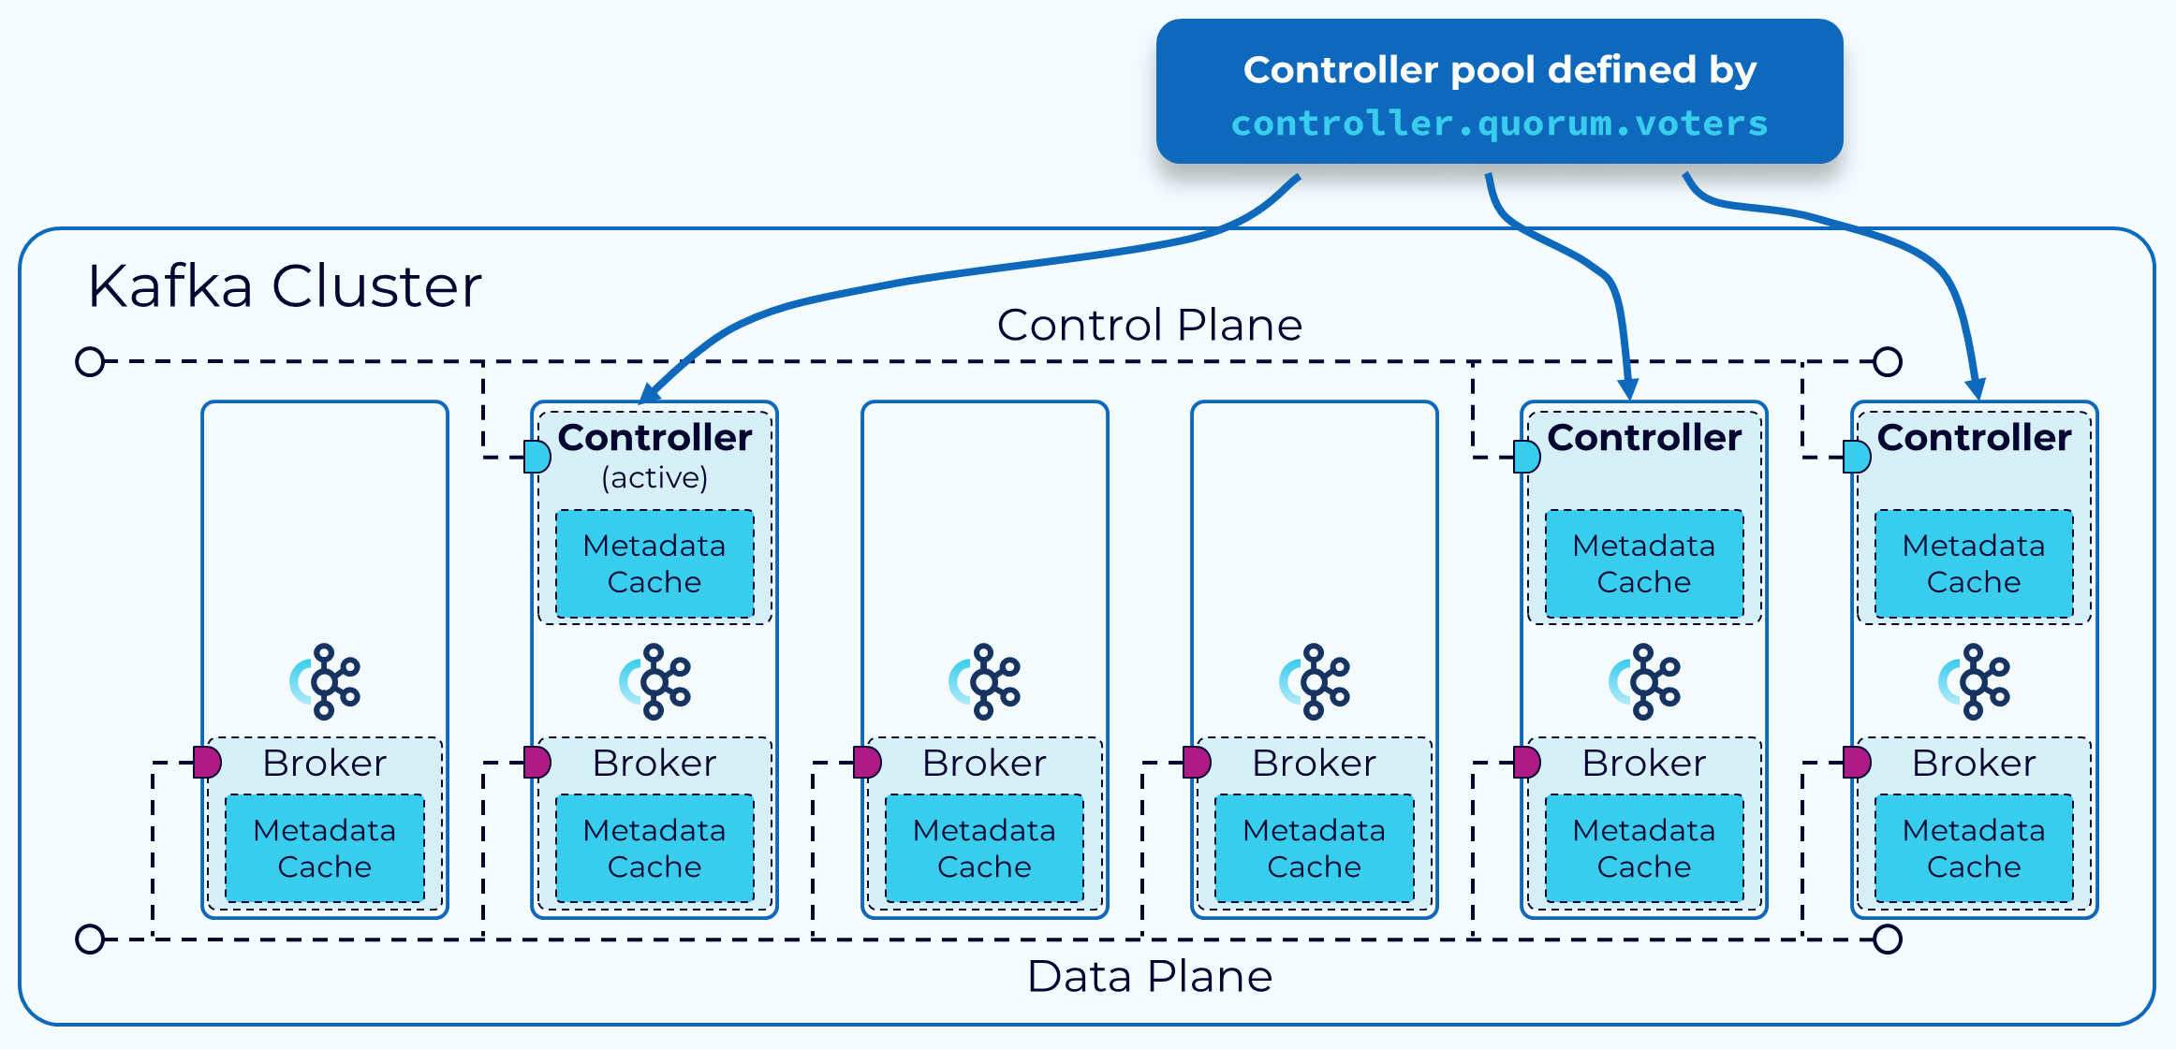

Slide 90
The brokers that serve as controllers, in a KRaft mode cluster, are listed in the controller.quorum.voters configuration property that is set on each broker. This allows all of the brokers to communicate with the controllers. One of these controller brokers will be the active controller and it will handle communicating changes to metadata with the other brokers.
All of the controller brokers maintain an in-memory metadata cache that is kept up to date, so that any controller can take over as the active controller if needed. This is one of the features of KRaft that make it so much more efficient than the ZooKeeper-based control plane.

Slide 91
KRaft Cluster Metadata

Slide 92
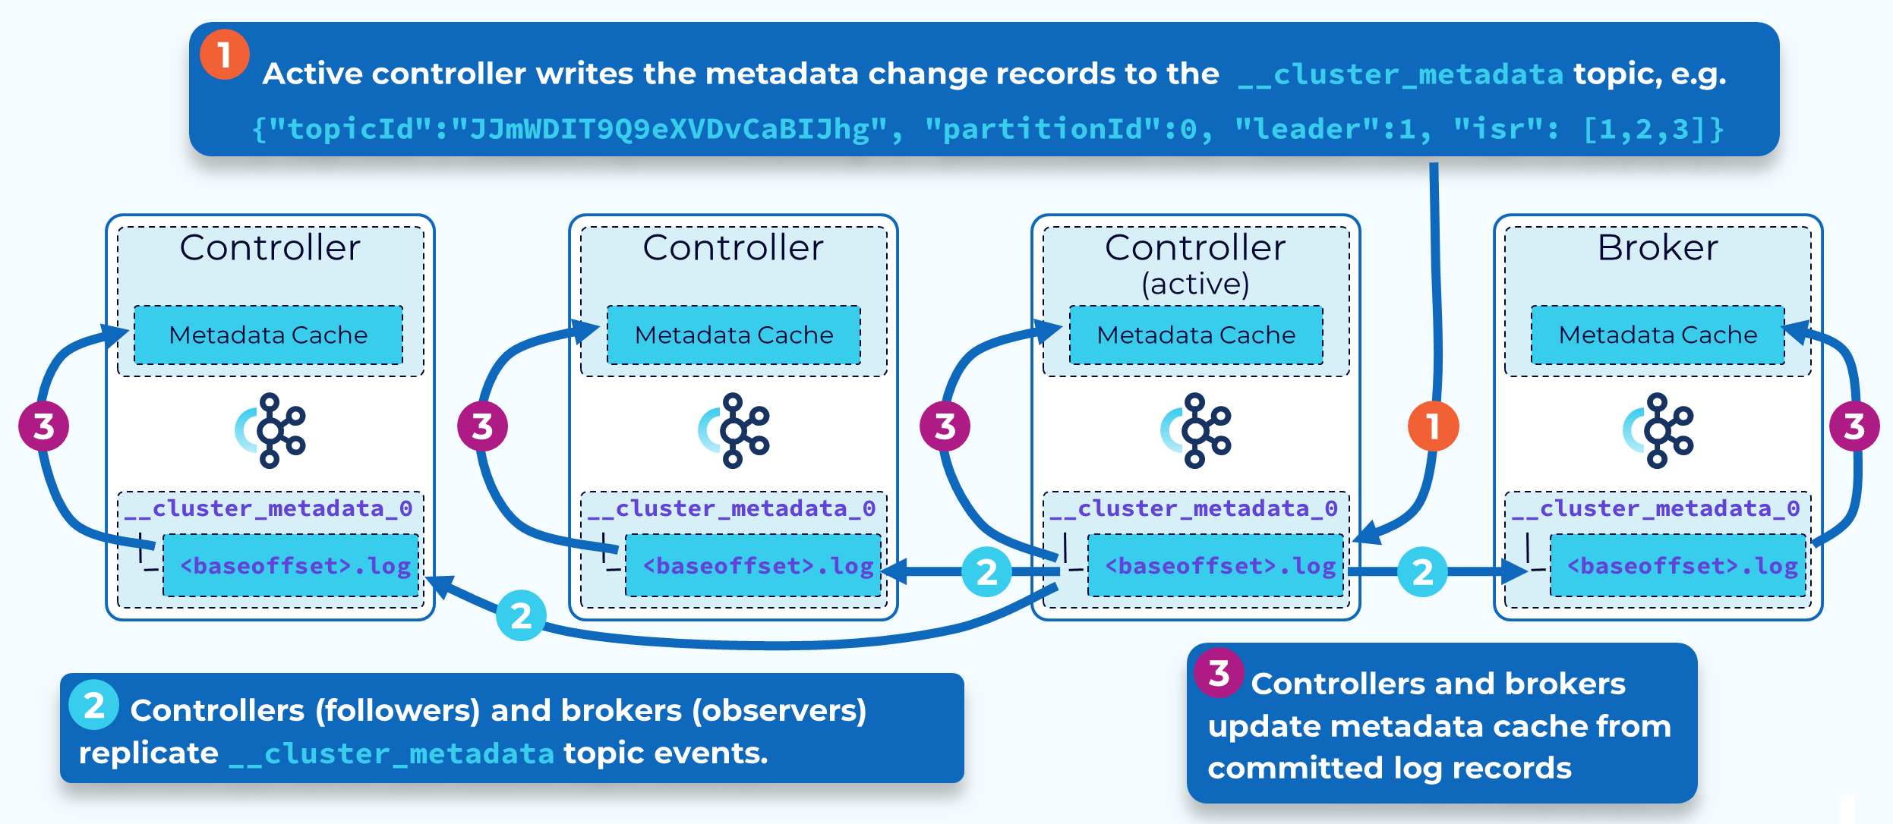

Slide 93
KRaft is based upon the Raft consensus protocol which was introduced to Kafka as part of KIP-500 with additional details defined in other related KIPs. In KRaft mode, cluster metadata, reflecting the current state of all controller managed resources, is stored in a single partition Kafka topic called __cluster_metadata. KRaft uses this topic to synchronize cluster state changes across controller and broker nodes.
The active controller is the leader of this internal metadata topic’s single partition. Other controllers are replica followers. Brokers are replica observers. So, rather than the controller broadcasting metadata changes to the other controllers or to brokers, they each fetch the changes. This makes it very efficient to keep all the controllers and brokers in sync, and also shortens restart times of brokers and controllers.

Slide 94
KRaft Metadata Replication

Slide 95
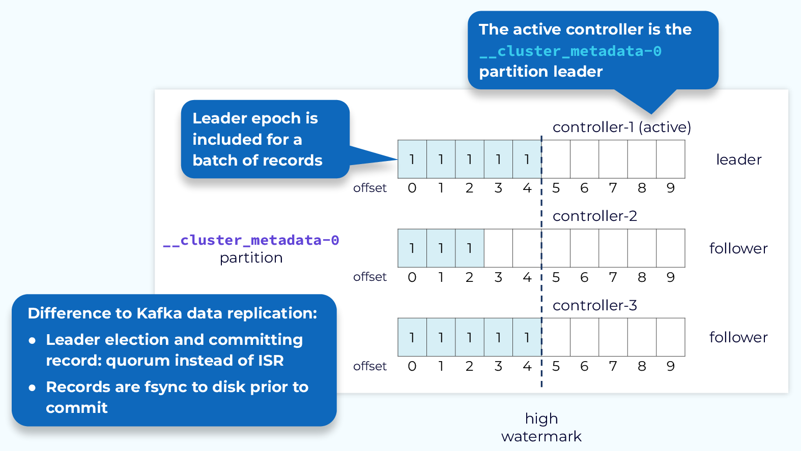

Slide 96
Since cluster metadata is stored in a Kafka topic, replication of that data is very similar to what we saw in the data plane replication module.
The active controller is the leader of the metadata topic’s single partition and it will receive all writes. The other controllers are followers and will fetch those changes.
We still use offsets and leader epochs the same as with the data plane. However, when a leader needs to be elected, this is done via quorum, rather than an in-sync replica set.
So, there is no ISR involved in metadata replication. Another difference is that metadata records are flushed to disk immediately as they are written to each node’s local log.

Slide 97
Leader Election –Vote Request

Slide 98
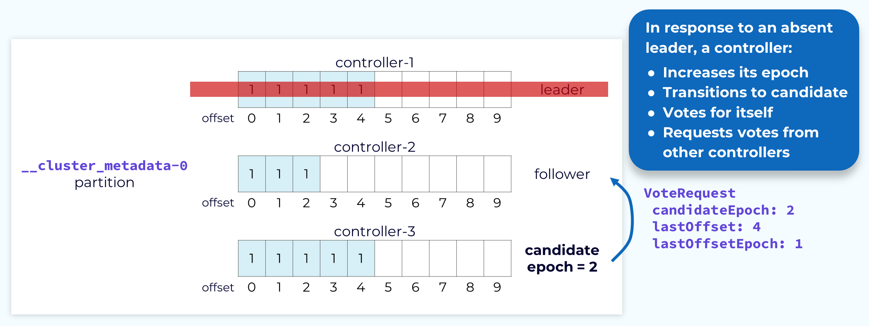

Slide 99
When the leader controller needs to be elected, the other controllers will participate in the election of a new leader.
A controller, usually the one that first recognized the need for a new leader, will send a VoteRequest to the other controllers. This request will include the candidate’s last offset and the epoch associated with that offset. It will also increment that epoch and pass it as the candidate epoch. The candidate controller will also vote for itself for that epoch.

Slide 100
Vote Response

Slide 101
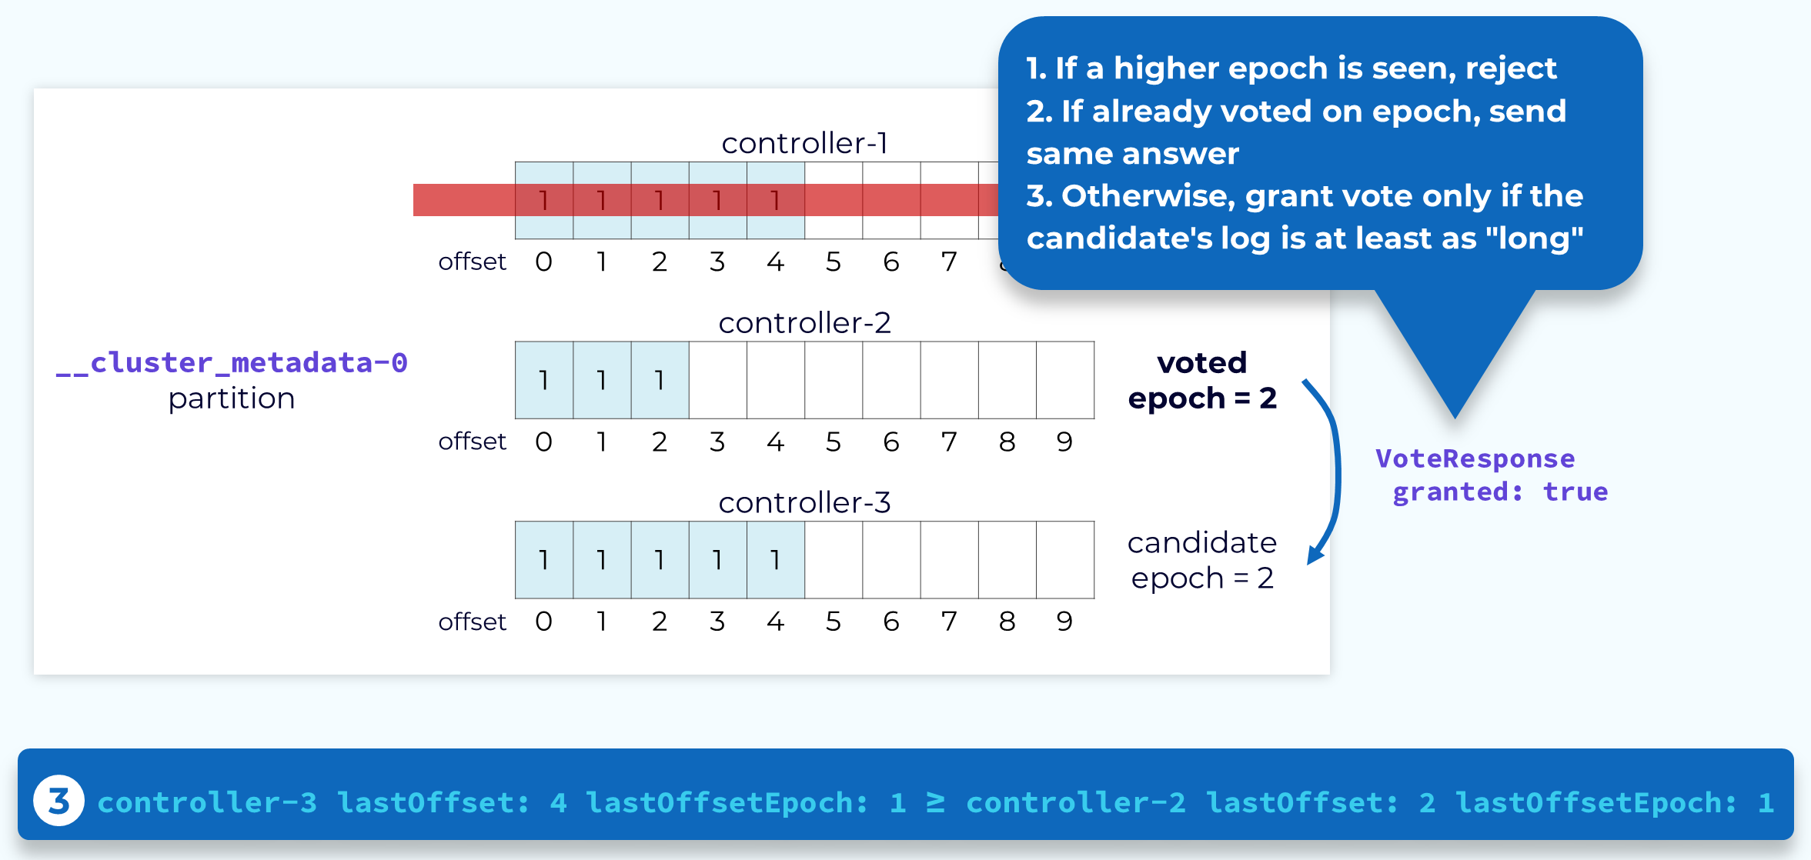

Slide 102
When a follower controller receives a VoteRequest it will check to see if it has seen a higher epoch than the one being passed in by the candidate. If it has, or if it has already voted for a different candidate with that same epoch, it will reject the request. Otherwise it will look at the latest offset passed in by the candidate and if it is the same or higher than its own, it will grant the vote. That candidate controller now has two votes: its own and the one it was just granted. The first controller to achieve a majority of the votes becomes the new leader.

Slide 103
Completion

Slide 104
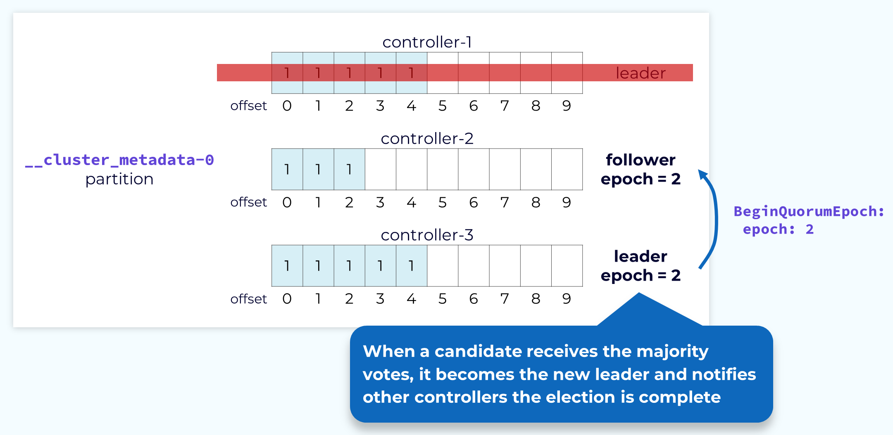

Slide 105
Once a candidate has collected a majority of votes, it will consider itself the leader but it still needs to inform the other controllers of this. To do this the new leader will send a BeginQuorumEpoch request, including the new epoch, to the other controllers. Now the election is complete. When the old leader controller comes back online, it will follow the new leader at the new epoch and bring its own metadata log up to date with the leader.

Slide 106
Metadata Replica Reconciliation

Slide 107
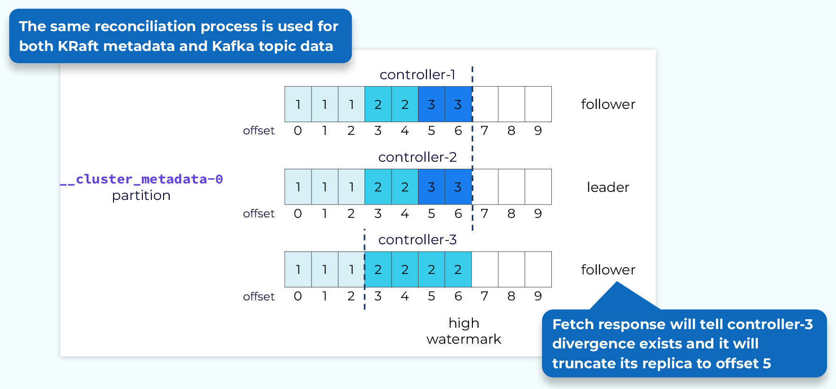

Slide 108
After a leader election is complete a log reconciliation may be required.
In this case the reconciliation process is the same that we saw for topic data in the data plane replication module. Using the epoch and offsets of both the followers and the leader, the follower will truncate uncommitted records and bring itself in sync with the leader.

Slide 109
KRaft Cluster Metadata Snapshot

Slide 110
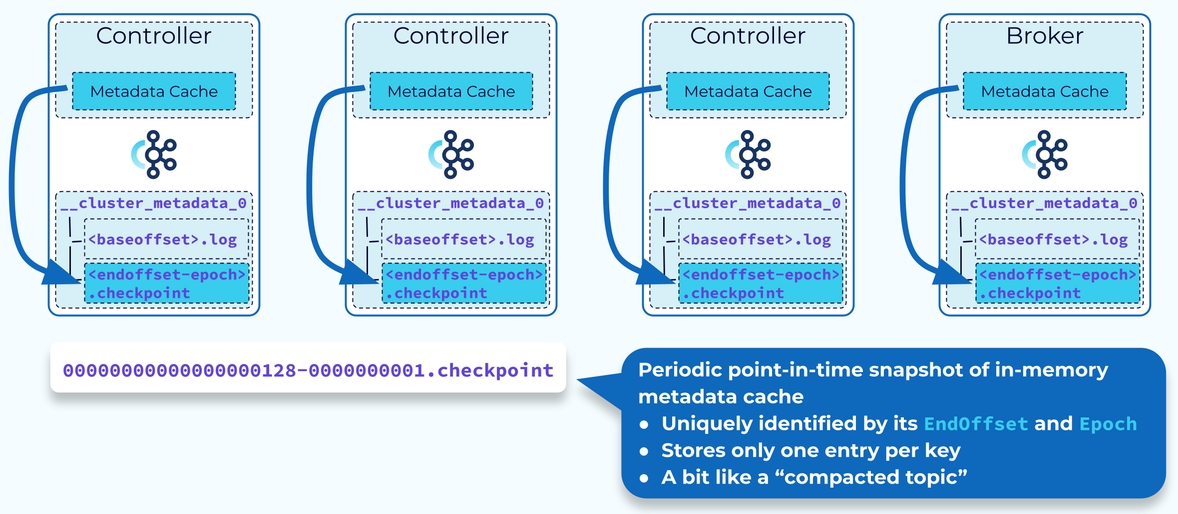

Slide 111
There is no clear point at which we know that cluster metadata is no longer needed, but we don’t want the metadata log to grow endlessly.
The solution for this requirement is the metadata snapshot. Periodically, each of the controllers and brokers will take a snapshot of their in-memory metadata cache.
This snapshot is saved to a file identified with the end offset and controller epoch. Now we know that all data in the metadata log that is older than that offset and epoch is safely stored, and the log can be truncated up to that point. The snapshot, together with the remaining data in the metadata log, will still give us the complete metadata for the whole cluster.

Slide 112
When a Snapshot Is Read

Slide 113
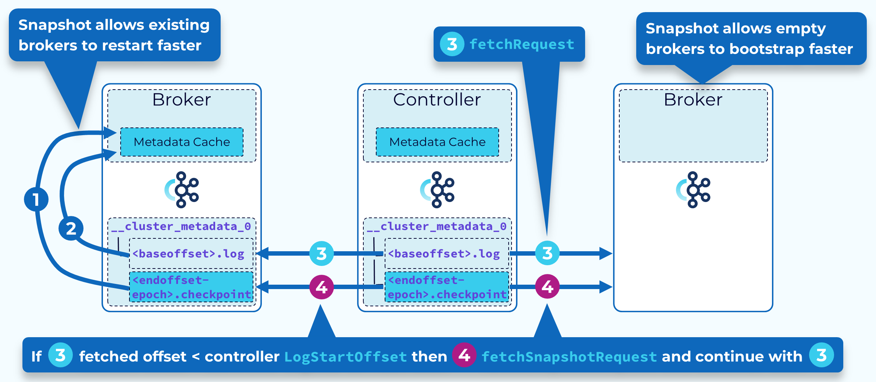

Slide 114
Two primary uses of the metadata snapshot are broker restarts and new brokers coming online.
When an existing broker restarts, it (1) loads its most recent snapshot into memory. Then starting from the EndOffset of its snapshot, it (2) adds available records from its local __cluster_metadata log. It then (3) begins fetching records from the active controller. If the fetched record offset is less than the active controller LogStartOffset, the controller response includes the snapshot ID of its latest snapshot. The broker then (4) fetches this snapshot and loads it into memory and then once again continues fetching records from the __cluster_metadata partition leader (the active controller).
When a new broker starts up, it (3) begins fetching records for the first time from the active controller. Typically, this offset will be less than the active controller LogStartOffset and the controller response will include the snapshot ID of its latest snapshot. The broker (4) fetches this snapshot and loads it into memory and then once again continues fetching records from the __cluster_metadata partition leader (the active controller)

